Slide 1

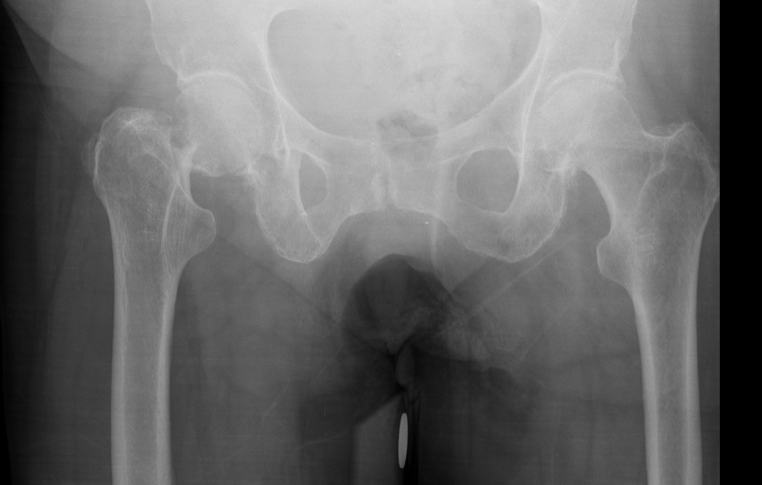
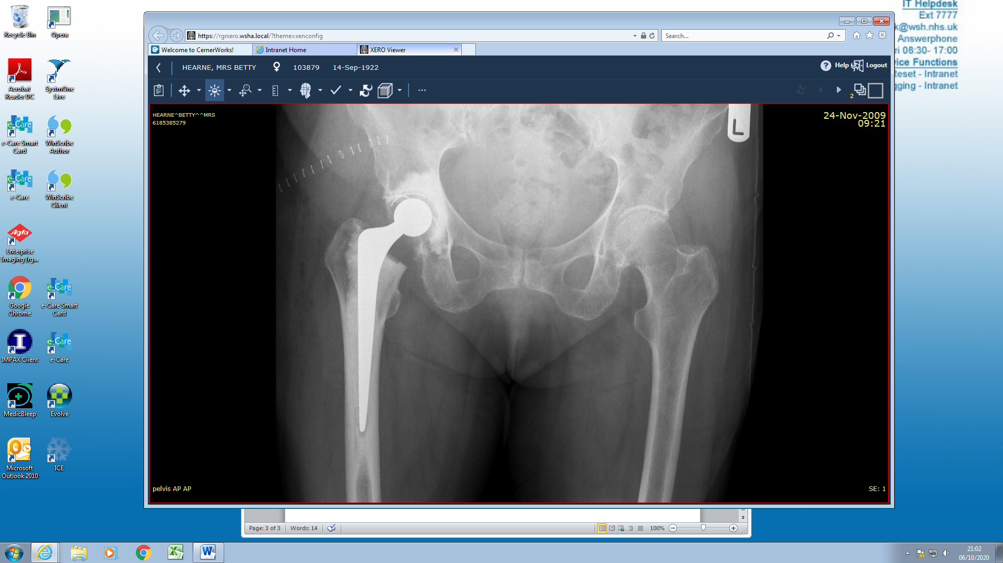
v
Total hip arthroplasty for hip fracture:
Clinical results and survivorship >400 patients
from 2005-2020
Mr James Gill (ST8)
Dr Aly Pathan FY2
Mr Sam Parsons
Mr Konrad Wronka
Notes:
Thank you for this opportunity to talk about the results of total hip arthroplasty for hip fracture

Slide 2
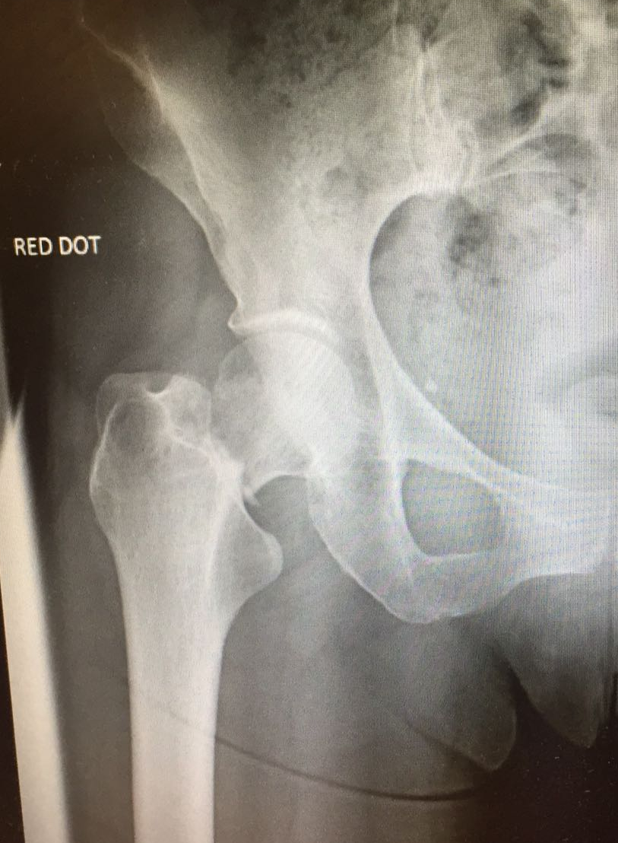

Background
v
  Literature struggling to show benefit from THA over hemi:
  2019 HEALTH Trial, Bhandari, NEJM¹
Bhandari M, Einhorn TA, Guy-Att G, et al. Total Hip Arthroplasty or Hemiarthroplasty for Hip Fracture. N Engl J Med 2019;381:2199– 208.
Notes:
In recent years a number of large studies has questioned the benefit of THA versus hemiarthroplasty for treating hip fractures.
My interest in this topic was heightened in 2017 when my mum suffered a hip fracture
Beinn Eighe 1010m

Slide 3
Aim
v
  Assess the outcomes of all THA done for acute displaced intracapsular #NOF 2005 -2020
Notes:
The aim of this study was to assess the outcomes of all THAs performed at the West Suffolk for acute hip fracture since the commencement of the NJR in 2005.

Slide 4
Patient & Implant Characteristics
Patient Characteristics
%
Age, years (mean ± SD)
73.2±8.0
Female
308
74.4
Male
106
25.6
  414 THAs
Patient Characteristics
Age, years (mean ± SD) | 73.2 ± 8.0
Female | 74.4 %
Implant characteristics | %
Cemented Exeter | 90
Hybrid | 10
Notes:
A total of 414 total hip replacements were performed.
The mean age of patients was 73 and 74% were female.
90% of patients had cemented total hips

Slide 5
Methods
v
  Outcome measures:
    Revision
    Dislocation
    Periprosthetic # and contra-lateral #NOF
    Mortality
    Modified Harris Hip Score
Notes:
We assessed 5 outcome measures.
Revision
Dislocation
Periprosthetic fracture and contralateral hip fracture
Mortality
And modified Harris Hip Score

Slide 6
Age
Sex
Time (months)
Reason for revision
Results: 1 .Revisions
9 revisions
6 for dislocation
1 Revision of stem
1 Revision to constrained cup
4 PLAD
3 for infection
2 x DAIR
1 x Revision at RNOH – procedure unknown
Notes:
There were a total of 9 revisions at a mean of 27 months following THA
6 were for dislocation and 3 were for infection

Slide 7
Age
Sex
Time (months)
Reason for revision
Results: 1. Kaplan Meier Implant Survivorship
Notes:
Kaplan-Meier implant survivorship at 10 years was 97.7%

Slide 8
Results: 2. Dislocations
v
  Number of patients suffered a dislocation 20
  Mean time to 1st dislocation 14 months
  If suffer 1 dislocation chance of second 55%
Notes:
In total 20 patients suffered at least one dislocation
The mean time to 1st dislocation was 14 months
And if a patient suffered one dislocation the chance of a second dislocation was 55%

Slide 9
Results: 2. Kaplan Meier Dislocation
v
Notes:
The probability of suffering at least one dislocation within one year was 2.9% and within 5 years was 4.4%

Slide 10
Results: 3. Fracture
v
Periprosthetic THA fracture
3 (0.7%)
Contra-lateral hip fracture
22 (5.3%)
Notes:
3 patients suffered periprosthetic fractures and 22 patients contralateral hip fractures
So the risk of breaking the other hip was 7.5x greater that of suffering a periprosthetic fracture
This highlights the importance of falls and osteoporosis prevention

Slide 11
Results: 4. Kaplan Meier Mortality
v
30 day = 1%
n =410
1 year = 4.8%
n =394
10 years = 28.8%
n =127
Notes:
Mortality
The probability of a patient dying within 30 days was 1% and within 1 year was 5%

Slide 12
Results: 5. PROMS
v
  Modified Harris Hip Score:
  1 year mean = 87.9
Notes:
PROMs were available for 80% of patients who were alive at 1 year
For reference any score over 80 is classified as good

Slide 13
Discussion
v
Percentage NICE eligible displaced intracapsular fractures treated with THA 2015-2019²
Ipswich | 5.3%
Colchester | 15.3
Norfolk and Norwich | 17.0
Peterborough | 20.1
Luton & Dunstable | 22.6
Addenbrooke's | 23.1
Bedford | 25.4
Broomfield Chelmsford | 25.7
UK average | 31.1
West Suffolk | 32.3
Southend | 34.1
James Paget | 36.2
King's Lynn | 36.3
Basildon | 37.4
Harlow | 41.8
Lister | 46.0
NICE CG124³
Offer THA if:
Walk independently outdoors with no more than one stick
Not cognitively impaired
Fit to undergo anaesthesia and the procedure [8].
2. NHFD Benchmark tables, Surgery
3. National Clinical Guideline Centre. CG124: The management of hip fracture in adults. Health Technol Assess (Rockv) 2011;:68–81.
Notes:
There is wide variation around the East of England for % of patients who are eligible for a THA according to the NICE guidelines who are treated with a total hip for a hip fracture
This table shows 5 years of data from the national hip fracture database
The national average is ~ 31.1%
So the WSH sits somewhere in the middle
QUESTIONS:
Geographic variation in patient demographics
Peterborough – artificially low because Mr Parker will fix a significant number
Results fairly consisted between years
Anecdotally this fits with what I have seen
Data is collected by the individual units

Slide 14
Limitations, strengths and the future
v
  ✗ Selection criteria
  ✓ This cohort have done well following THA for hip fracture
  What is needed?
  Evidence to guide indications
Notes:
Unfortunately this study does not provide guidance on selection criteria – patients were treated according to the preference of the operating surgeon
What it does do is show that this cohort have done well following THA
Further evidence is needed to help guide clinicians on which patients would benefit from THA

Slide 15
v
Take-home message
Implant survivorship 97.7% at ten years
Dislocation 4.4% at 5 years
Risk of peri-prosthetic THA# 0.7%
Mortality 4.8% at one year
@james_r_gill
Notes:
So the take home messages from this talk are:
Implant survivorship 97.7% at ten years
Dislocation risk 4.4% at 5 years
Risk of peri-prosthetic fracture 0.7%
And mortality 4.8% at one year

Slide 16
References
v
Bhandari M, Einhorn TA, Guy-Att G, et al. Total Hip Arthroplasty or Hemiarthroplasty for Hip Fracture. N Engl J Med 2019;381:2199–208.
NHFD Benchmark tables, Surgery https://www.nhfd.co.uk/20/nhfdcharts.nsf/fmBenchmarks?readform
National Clinical Guideline Centre. CG124: The management of hip fracture in adults. Health Technol Assess (Rockv) 2011;:68–81.
Viswanath A, Malik A, Chan W, et al. Treatment of displaced intracapsular fractures of the femoral neck with total hip arthroplasty or hemiarthroplasty. Bone Joint J 2020;102-B:693–8.

Slide 17
APPENDIX: NNUH Hemi vs. THA BJJ 2020⁴
v
  N =2721
  2006-2016 Hemi=2494 THA=227 (8.4%) versus 16% of all displaced IC#NOF
  No difference in revision rate or rate of infection
  THA higher dislocation rate dislocation 3.96 versus 1.2 (only 3 THA revised for dislocation)
  THA increased risk of periprosthetic fracture 1.76% vs. 0.36% (both low)
  THA higher rate of trochanteric bursitis
  THA 10 yr mortality 33.3% versus 71.2% for hemi
  More THA unplanned return to clinic with pain 8.4% vs 1.2%
  More THA unscheduled return to clinic 60/227 vs. 126/2494
  Limitations:
  Bias due to lack of formal FU for hemiarthroplasty
  THA much better survivorship so skewed risk of complications unless perform KM analysis to assess how many hips are at risk
  Take home message:
  NICE guidelines are pretty useless at guiding decision making
4. Viswanath A, Malik A, Chan W, et al. Treatment of displaced intracapsular fractures of the femoral neck with total hip arthroplasty or hemiarthroplasty. Bone Joint J 2020;102-B:693–8.
Notes:
Very informative study
Highlights the risks of doing THA for hip fracture
Dislocation
Trochanteric bursitis
More likely to complain of pain
However I am not sure it is fair to compare incidence of trochanteric bursitis in patients who are followed up at 1 year compared to those that are not.
Survivorship potentially skews complications (living patients are more likely to suffer a complication)
I completely agree with the take home message that NICE guidelines are of no help and we desperately need more evidence

Slide 18
APPENDIX: Revision PLADs
v
PLAD
1. 7 dislocations then PLAD then no further dislocations
2. 2 dislcoations then PLAD then no further dislcoations
3. 3 dislocations then PLAD then fracture 18 months later, re-revision to long uncemented stem then 4th dislocations
4. 1 dislocation day 1 post op unsuccessful closed reduction then no further dislocations
4. Viswanath A, Malik A, Chan W, et al. Treatment of displaced intracapsular fractures of the femoral neck with total hip arthroplasty or hemiarthroplasty. Bone Joint J 2020;102-B:693–8.

Slide 19
Age
Sex
Time (months)
Reason for revision
APPENDIX NJR Survivorship
  Implant survivorship favourable at 10 years
  94.8% NJR
  97.7% at WSH

Slide 20
APPENDIX Dislocation Meta-analysis
v

Slide 21
APPENDIX: NHFD since 2010 more data
v
  305 THA
  NICE guidance - Offer THA rather than hemi to patients who:
  Walk with no more than 1 aid 96%
  Not cognitively impaired (AMTS≥ 7) 100%
  Fit to undergo anaesthesia
  and procedure (ASA≤3) 99.3%
  Diagnosis to surgery:
  <36hrs 88.7%
  Median time 22.6 hours
Notes:
2 patients with ASA4
One was a 58yo male with multiple co-morbidities
Another was a patient with bony mets
Average time to surgery = 24.6

Slide 22
APPENDIX: Revision for Dislocation versus NJR
v
NJR
Total number of hips in NJR = 1091892
Total number of revisions for dislocation = 16091
Revisions for dislocation = 1.47%
0.86 / 1000 patient years
WSH
6 revisions for dislocation / 414 = 1.45%
Mean FU = 5.35 years
Patient years in study = 5.35x414 = 2214.9
6/2.2149 = 2.7 / 1000 patient years
  Risk of revision for dislocation 3.2 greater for #NOF (does not account for patients that have died)

Slide 23
APPENDIX: Contralateral hip fracture
v
  Contralateral hip fracture
  13 intracapsular 9 extracapsular Total = 22
  11 ETS 9 DHS
  2 THA
  Mean time = 47 months
Notes:
22 contralateral hip fracture versus
3 periprosthetic hip fracture

Slide 24
APPENDIX: Periprosthetic THA#
v
3 patients suffered periprosthetic fractures at a mean of 5 years following hip fracture surgery
1. Vancouver B1 fracture ORIF with Zimmer NCB plate 10/11/2019
2. B2 fracture revised to long uncemented stem. Previous revision with PLAD for dislocation
3. B1 fracture ORIF with Synthes plate and cables
Fracture treated with revision to long uncemented stem. Suffered a dislocation 5 years post THA dislocated again 3 days and again another 8 days later so revised 1st with a PLAD. 1 year later suffered fracture. 6 months later suffered 4th dislocation
Notes:
22 contralateral hip fracture versus
3 periprosthetic hip fracture

Slide 25
APPENDIX: Implants
v
 | Implant | Implant details | n
Classification of THA, n (%) | Cemented |  | 371 (89.6)
 | Hybrid |  | 40 (9.7)
 | Uncemented |  | 2 (0.5)
 | Reverse hybrid |  | 1 (0.2)
Femoral stem, n (%) | Cemented | Exeter V40 (Stryker) | 411 (99.3)
 | Uncemented | POLARSTEM (Smith and Nephew) | 3 (0.7)
Acetabular cup, n (%) | Cemented | Marathon (Depuy) | 159 (38.4)
 |  | Ogee Elite (Depuy) | 129 (31.2)
 |  | Exeter Contemporary (Stryker) | 57 (13.8)
 |  | REFLECTION (Smith and Nephew) | 12 (2.9)
 |  | Cenator (Corin) | 15 (3.6)
 | Uncemented | R3 (Smith and Nephew) | 41 (9.9)
 |  | Trident (Stryker) | 1 (0.2)
Head size (mm), n (%) |  | 22.5 | 4 (1)
 |  | 26 | 113 (27.3)
 |  | 28 | 289 (69.8)
 |  | 32 | 6 (1.4)
 |  | 36 | 2 (0.5)
Surgical approach |  | Posterior | 358 (86.5)
 |  | Anterior lateral | 56 (13.5)

Slide 26
APPENDIX % eligible displaced IC#NOF treated with THA
v
 | 2015-2019 |  | 2019 |  | 2018 |  | 2017 |  | 2016 |  | 2015
 | % eligible | N all #NOF | n all #NOF | % eligible | n all #NOF | % eligible | n all #NOF | % eligible | n all #NOF | % eligible | n all #NOF | % eligible
Ipswich | 5.28 | 2351 | 477 | 8.6 | 497 | 6.8 | 451 | 5.6 | 492 | 3.3 | 434 | 2.1
Colchester | 15.28 | 2809 | 579 | 18.2 | 541 | 12.9 | 580 | 14.4 | 527 | 22.9 | 582 | 8
Norfolk and Norwich | 17.02 | 4140 | 842 | 15.8 | 816 | 13.1 | 845 | 16.7 | 806 | 22.7 | 831 | 16.8
Hinchingbrooke | 19.56 | 977 | 192 | 24.3 | 210 | 18.4 | 180 | 23.1 | 206 | 12 | 189 | 20
Peterborough | 20.1 | 2384 | 507 | 12.2 | 480 | 24 | 486 | 50 | 456 | 14.3 | 455 | 0
Luton & Dunstable | 22.64 | 1527 | 334 | 31.3 | 297 | 24.7 | 291 | 21.8 | 310 | 17.9 | 295 | 17.5
Addenbrooke's | 23.12 | 2002 | 428 | 22.9 | 394 | 27.5 | 410 | 24.1 | 429 | 18.3 | 341 | 22.8
Bedford | 25.4 | 958 | 251 | 23.5 | 288 | 48.1 | 207 | 24 | 50 | 14.3 | 162 | 17.1
Broomfield Chelmsford | 25.74 | 2303 | 441 | 32.8 | 484 | 28.4 | 455 | 27.8 | 455 | 12.7 | 468 | 27
West Suffolk | 32.32 | 1781 | 346 | 29.3 | 382 | 48.8 | 387 | 41.6 | 326 | 20.8 | 340 | 21.1
Southend | 34.14 | 2381 | 488 | 37.3 | 485 | 35.2 | 491 | 31.8 | 485 | 38.6 | 432 | 27.8
James Paget | 36.16 | 2037 | 397 | 45.1 | 376 | 50.9 | 450 | 36.9 | 421 | 22.9 | 393 | 25
King's Lynn | 36.32 | 1983 | 361 | 35.3 | 412 | 44.3 | 423 | 36.7 | 401 | 31.5 | 386 | 33.8
Basildon | 37.44 | 2006 | 393 | 40.2 | 433 | 31.7 | 389 | 30.4 | 399 | 37.5 | 392 | 47.4
Harlow | 41.78 | 1791 | 356 | 53.1 | 359 | 49.2 | 355 | 39.7 | 356 | 37.9 | 365 | 29
Lister | 46.04 | 2219 | 425 | 47.2 | 495 | 53.2 | 444 | 40.4 | 433 | 53.4 | 422 | 36

Slide 27
APPENDIX: Modified Harris Hips Score
v
Modified Harris Hip Score
The modified HHS was available for 280 patients out of 361 (78%) patients who were alive and had completed one year of follow-up.
The mean modified HHS at latest follow-up was 86.3±18.9.
Latest follow-up was five years post THA for 75 patients and one-year for 205 patients resulting in a mean follow interval of 25 months for the modified HHS.
The mean modified HHS was 87.9±17.1 and 80.6±19.5 at one- and five-year follow-up respectively.

Slide 28
APPENDIX: My thoughts
v
NICE criteria cast the net too wide because there is no better evidence.
Might be more appropriate is said do not do consider THA:
If pt walks with more than a single stick / is not independent outdoors
Not cognitively intact
Not for for procedure or anaesthetic
HEALTH trial used NICE criteria as selection criteria as a result ended up with average age of 80 yrs. Result of trial useful because showed no difference between THA and hemi in that group of patients.
Notes:
The selection criteria used by the HEALTH trial was similar to the NICE guidance for which patients should be considered for a THA.
As a result they ended up with a mean age of 80 years.
And showed no difference in outcomes.
The HEALTH study results are valuable because it tells us not all patients that meet NICE criteria benefit from THA.

Slide 29
APPENDIX: Tipping point
v
Function
Risk of complications
NICE guidelines
Quantity
Age
Notes:
As function declines patients are less able to realise the improved function associated with a THA
As patients age risk of complications increases

