Slide 2
Aim
Objective: Devise a classification system for thoracolumbar injuries that assists in clinical decision making
Notes:
Existing scoring systems strive only as descriptors not predictors
Operative versus non operative treatment and surgical approach

Slide 3
Background
Existing scoring systems inadequate
Notes:
Existing scoring systems strive only as descriptors not predictors
Operative versus non operative treatment and surgical approach

Slide 4
Methods
Literature review
40 spine surgeons, 15 institutions from 9 countries (not UK)
Canvassed with respect to information deemed pivotal in decision making TL trauma
Reliability and validity of new scoring system tested on the surgeons using 127 cases (separate work)

Slide 5
Results = Factors important for a classification
3 variables:
Morphology of injury
Integrity of posterior ligamentous complex (PLC)
Neurologic status
Injury severity score:
If multiple levels involved only the most severely involved level is scored

Slide 6
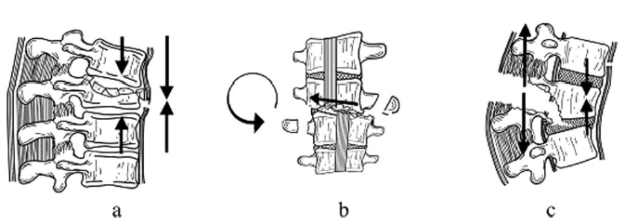
1. Morphology (Similar to )
Integration of info from plain film radiographs, CT & MRI
Morphology descriptions includes level

Slide 7
Compression Distraction
Additional point for burst
Notes:
Only score the highest morphologic sub group if multiple morphologic features are present.
Only score morphology if clearly present. I.e. should not score distraction if PLC is scored as indeterminate

Slide 8
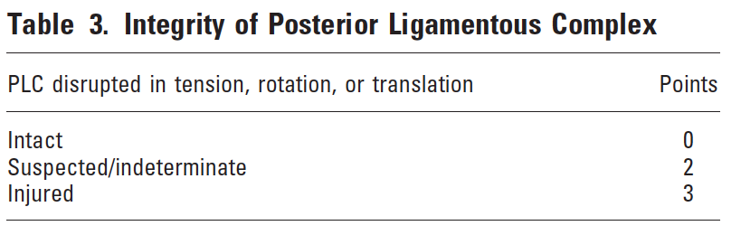
2. Integrity of the posterior ligamentous complex
Protects spine against excessive flexion, rotation, translation and distraction
PLC poor healing so once disrupted generally requires surgical stabilization
Assessed with plain film radiographs, CT, MRI and clinical examination

Slide 9
3. Neurologic status
Notes:
Complete Asia A, incomplete Asia B-D

Slide 10
Surgical approach
TLICS:
≤ 3 non-operative
4 either or
≥ 5 surgical
Notes:
The general principles are:
1) an incomplete neurologic injury generally requires an anterior procedure if neural compression from the anterior spinal elements is present following attempts at postural or open reduction
2) PLC disruption generally requires a posterior procedure; and
3) a combined incomplete neurologic injury and PLC disruption generally requires a combined anterior and posterior procedure.

Slide 11
Influencing qualifiers
Local factors: Comorbidities:
Extreme kyphosis or collapse - Sternum fracture
Lateral fracture angulation - Severe closed head injury
Open fractures - Limb amputation
Overlying burns - Polytrauma
Multiple adjacent rib fractures - RA - AS - OP
- Age
- Obesity
- General health
“There is no treatment algorithm that can supersede a surgeon’s intuition in prioritizing and integrating a multitude of complex clinical and biomechanical issues.”

Slide 12
Evolution
TLICS led to new AO Spine classification which incorporates neurology and guides operative management

Slide 13
Pitfalls of classification
1) either there is a loss of information content in favor of simplicity and
thus higher reproducibility
2) there is a loss of simplicity and reproducibility in favor of higher informational content.
Modification from earlier TLICS injury mechanism changed to injury morphology

