Slide 1

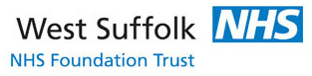
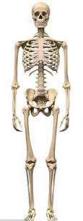
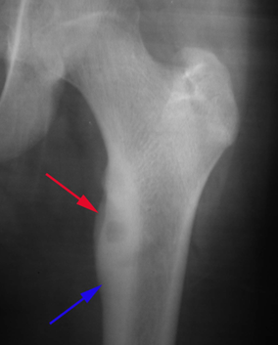
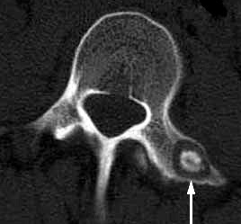
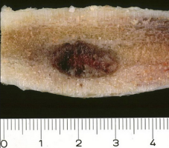
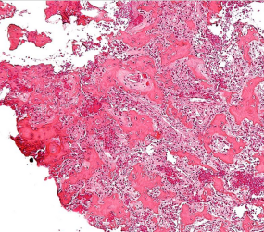
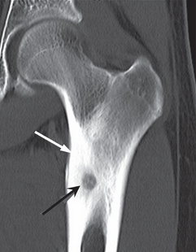
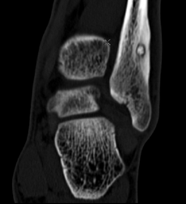
Osteoid Osteoma
ST3 James Gill
Classification
Benign primary bone tumour. Osteogenic tumour arising from osteoblasts.
Epidemiology
Occur at any age, and are most common in patients between the ages of 4 and 25 years old (80% < 30 years).
Male predominance ~ 3:1
Location
Can occur in any bone, most commonly in long bones. Over half of cases occur in the femur or tibia (more commonly around the knee).
Presentation
The most common symptoms is persistent pain (24 hours) including at rest (maybe noticed more at night). Sometimes localised, sometimes referred over a widespread area. Typically relieved by NSAIDs (maybe only initially, maybe of years). Other symptoms include: limping, muscle atrophy, bowing, deformity, swelling and increased or decreased bone growth.
Most common cause of painful scoliosis in the adolescent population
Investigation
Xray & CT: Important radiographic feature is a small radiolucent area, the so-called ‘nidus’. Lesions in the diaphysis are surrounded by a dense sclerosis and cortical thickening. Lesions in the metaphysis show less cortical thickening.
^{99m}TcMDP scintigraphy reveals intense, localised activity.
Appearance
Macroscopic: <1cm. Excised lesions appear as a dark-brown or reddish ‘nucleus’ surrounded by dense bone; the central area consist of unorganised sheets of osteoid and bone cells.
Microscopic: Histologically virtually indistinguishable from osteoblastoma.
Nidus: central nodule of woven / anastomosing bone trabeculae and osteoid with osteoblastic rimming (see slide)
Reactive zone: area of thickened bone and fibrovascular tissue
Prognosis
The is no risk of malignant transformation.
pain from lesions usually resolves after an average of 3 years
The lesion spontaneously resolves in 5-7 years
Nidus and reactive zone
Management
Observations and NSAIDs. ~50% can be treated with NSAIDs alone.
Percutaneous CT guided radiofrequency ablation (RFA). Relative indications: failure of medial Mx, periarticular lesions and depending on the proximity to neural elements some spinal lesions. 90% successfully treated with 1-2 sessions of RFA. 10 % recurrence rate.
Surgical resection lesions not amenable to RFA. 94% success with local excision.
DDx
It is sometimes difficult to distinguish an osteoid osteoma from a small Brodies abscess without biopsy. Ewing’s sarcoma and chronic periostitis must also be excluded.

