Slide 1
Iowa studies have changed our understanding of the natural history of adolescent idiopathic scoliosis
Studies like this were was only possible before the introduction of surgical correction with Harrigton rods in the 1960’s

Slide 2
Intro
Prevalence 2-3% of 10-16 yr olds
Small curves F=M, larger curves F>M
<10% of actively screened patients require treatment
Pts being referred earlier through school screening programs
Therefore need a through knowledge of natural hx

Slide 3
Aim
Outline natural history for different curve patterns after skeletal maturity:
  Curve progression
  Back pain
  Psychosocial effects
  Mortality
  Effect on pulmonary attention

Slide 4
Patients
Diagnosed with significant curves 1932-1948
Review of records in 1978
219 patients ~ 120 with imaging available for analysis
Average follow up 40 years (range 31-51)
84% female

Slide 5
Curve progression
Curves < 30º at skeletal maturity tended not to progress regardless of curve pattern
Thoracic curves tend to be the most vulnerable to progression

Slide 6
Thoracic
Lumbar curves >30º progressed on average 19º
Curves 50-75º showed the most marked progression at 0.75-1º / year (n=11)

Slide 7
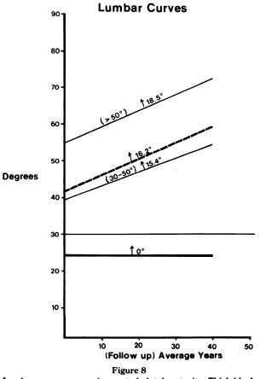
Lumbar
Lumbar curves <30º don’t progress
Curves >30º progressed on average 16.2º (n=17)
Right lumbar curves > 30º progressed twice as much as left
Prognostic factors for post maturity curve progression:
  Cobb angle >30º
  Degree of apical vertebral rotation
  Direction of curve
  Relationship of L5 to the intercrest line

Slide 8
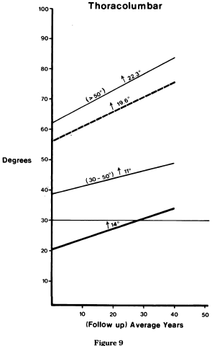
Thoracolumbar
Curves >30º progressed on average 19.6º during follow up (n=8)
Curves between 50-75º at maturity progressed on average 22.3º
Thoracolumbar curves have the highest propensity for developing lateral listhesis

Slide 9
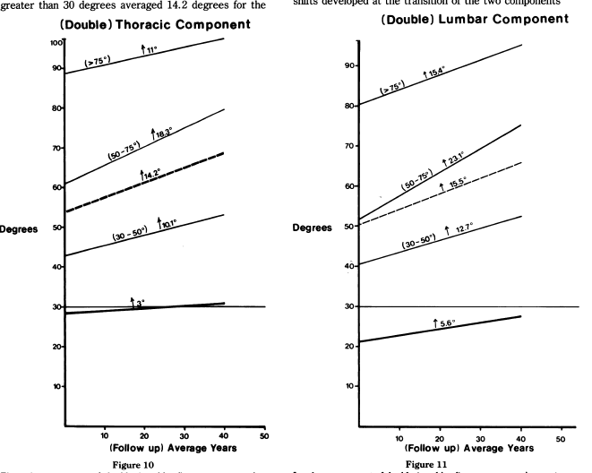
Double curves
Curves >30º progressed on average 14.2º (T) and 15.5º (L) Most marked progression was for curves 50-75º
  Thoracic 23.1º
  Lumbar 18.3º
Translatory shifts occur at the transition between components of curves > 80º
Extreme degrees of rotation not seen, unlike thoracic and lumbar curves. Ribs usually remain level.

Slide 10
Timing of curve progression
Major period of progression is between detection and maturity
The next most rapid period is from maturity to 30 years
Least from 30-40 years

Slide 11
Back Pain
40-60% (similar to general population)
Conversely scoliosis not over-represented in back pain prevalence studies
Pain associated with curves with translator shifts at the lower end of the curve and compensatory lumbo-sacral curve below L or TL curve
1% of patients with scoliosis with require surgery for back pain
Notes:
Some adults presenting with a lumbar curve and back pain may not be as a result of AIS. These patients may have degenerative scoliosis.

Slide 12
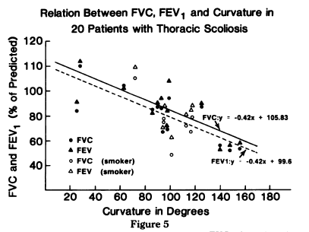
Pulmonary function
Only affects thoracic curves in which there is direct correlation between increasing curve magnitude and decreasing vital capacity
Pattern akin to restrictive lung disease
Limitation of forced vital capacity (FVC) and forced expiratory volume (1 sec) (FEV₁) does not occur until the curve approaches 100-120º
There is no such correlation with other curves

Slide 13
Mortality
< 100 degrees mortality comparable to general population
> 100 degrees mortality rate double
Most likely due to decreased pulmonary function and cor pulmonale in thoracic curves > 100 degrees

Slide 14
Effect on Pregnancy
No significant effect on pregnancy
Pregnancy may have deleterious effects on scoliosis particularly for younger patients

Slide 15
Limitations
Small number of patients

Slide 16
Impact
“Any proposed treatment must have a reasonable chance of altering the natural history in a positive way”
The recommendation to fuse thoracic curves that reach 50º at skeletal maturity is largely derived from the Iowa studies (based on 11 patients)

