Slide 1
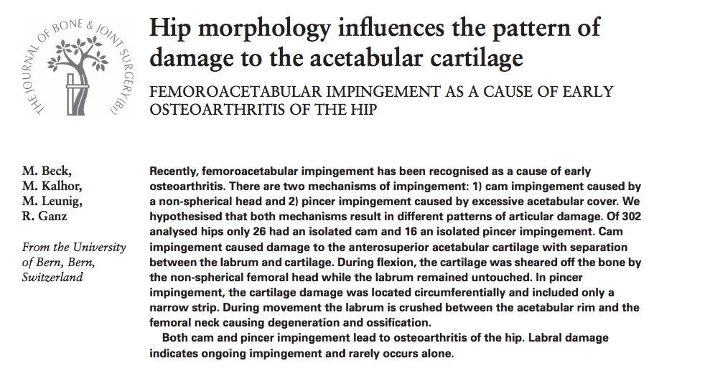

Slide 2
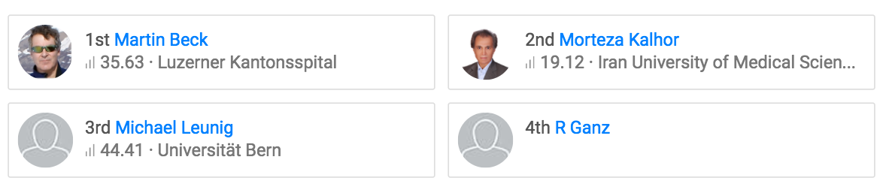
Authors
Institution: Bern

Slide 3
Background
FAI as a cause of OA recognised and described
Abutment of the acetabular rim and the femoral neck associated abnormalities of the:
  Proximal femur (Cam)
  Acetabulum (Pincer)

Slide 4
Hypothesis
Pattern of articular damage caused by cam impingement differs from that seen in impingement resulting from acetabular overcover

Slide 5
Cam / ‘pistol-grip’ / tilt deformity
Decreased or absent wasting of the junction of the femoral neck and head.
Aspherical junction between the head and neck. Increased radius of the femoral epiphysis as it joins the neck.
Also seen in slipped capital femoral epiphysis or in any hip in which the femoral neck is too large.
Abnormal junction is driven into the acetabulum producing damage to the cartilage in the area of the anterosuperior rim

Slide 6
Pincer
Excessive acetabular coverage
Results in impingement of of the femoral neck against the over covering acetabulum
Notes:
As seen in retroversion or a deep acetabulum (coxa profunda).
Coxa profunda = a hip in which the floor of the fossa acetabuli touches the ilioischial line

Slide 7
Methods
Retrospective cohort study
Data harvest from 302 hips treated for intra-articular pathology with surgical dislocation
  Pattern of OA recorded
  Plain film imaging reviewed
Notes:
June 1996 – April 2001

Slide 8
Inclusions | Exclusions (95)
Pistol-grip deformity with a normal acetabulum Coxa profunda with a normal proximal femur | Traumatic conditions (37) AVN (14) Incomplete or inadequate pre-operative xrays (52) Radiographic OA ≥ Tonnis grade 1 Perthes (7)
Notes:
In order to obtain unequivocal data, two well defined hip configurations were selected, which represent most closely the two mechanisms of impingement.
Mild OA only because as disease progresses information about the starting point obscured
Varus or valgus if centre of rotation > 5mm above or below the tip of the GT
Grade Description
0 No osteoarthritis signs
1 Mild:
increased osteosclerosis
minor joint space narrowing
no or minor loss of head sphericity
2 Moderate:
small bone cyst
moderate joint space narrowing
moderate loss of head sphericity
3 Severe:
large bone cysts
severe joint space narrowing, or joint space obliteration
severe deformity of the head

Slide 9
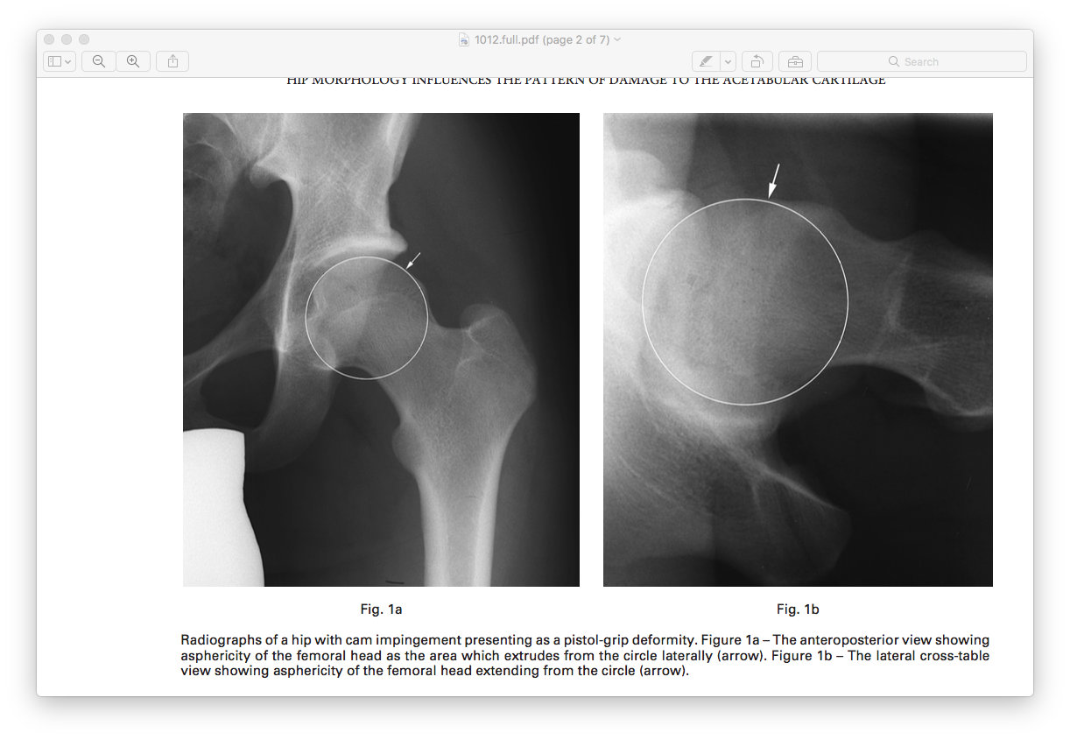
Cam
Notes:
Pistol grip deformity femoral head extends laterally in a convex shape to the base of the neck
Aspherical femoral head if protrudes out of a circle drawn on the lateral and extended anteriorly in a convex shape to the base of the neck.

Slide 10
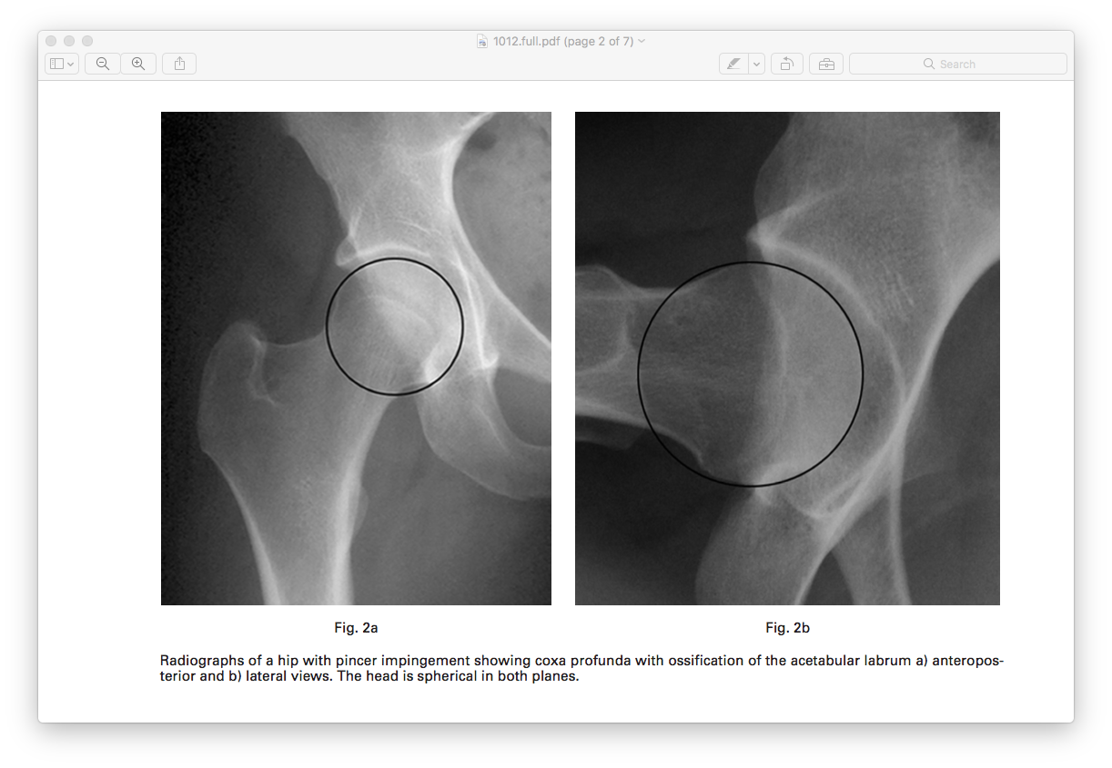
Pincer
Coxa profunda if the floor of the fossa acetabuli touched the ilioischial line

Slide 11
Pincer

Slide 12
Pincer

Slide 13
Evaluation of intra-articular damage
Labral and acetabular cartilage evaluated for stability
Width = Extent of cartilage lesion along the acetabular rim
Depth = Extension from the acetabular rim towards the acetabular fossa
Pathological changes documented on a diagram of the acetabulum divided into 12 sectors 6 o’clock being located in the middle of the incision acetabular notch.
Results depicted on a histogram displaying frequency distribution for the site of both acetabular and labral lesions. Mean size of cartilage lesion was calculated and displayed.

Slide 14
Results
57 Cam (17 combined with coxa profunda)
= 26 pure Cam
24 men, 2 women, mean age 32
54 coxa profunda (17 combined with Cam)
  = 16 isolated coxa
  2 men, 14 women, mean age 40

Slide 15
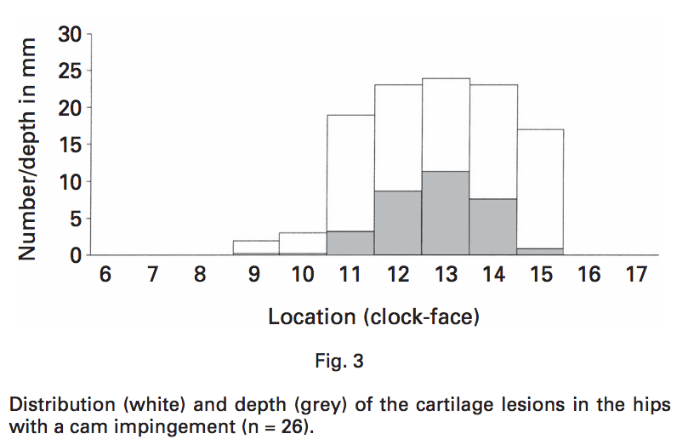
Cam
Most damage anterosuperiorly 1 o’clock
Mean depth 11mm
Caused separation between the labrum & cartilage. During flexion, the cartilage was sheared off the bone by the non-spherical femoral head while the labrum remained untouched.

Slide 16
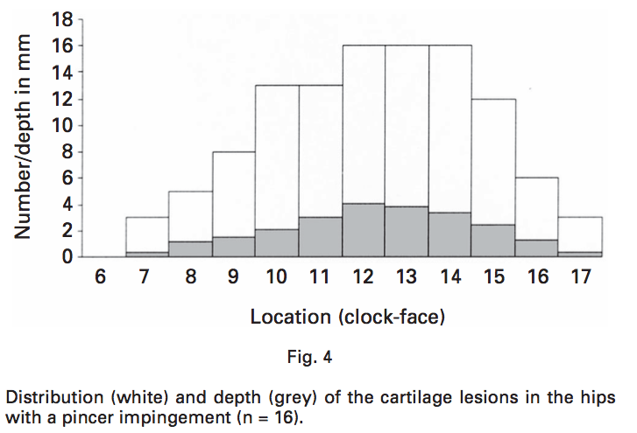
Pincer
Alterations of the labrum were circumferential
Damage restricted to a narrow circumferential band
During movement the labrum is crushed between the acetabular rim and the femoral neck causing labral degeneration and ossification.

Slide 17
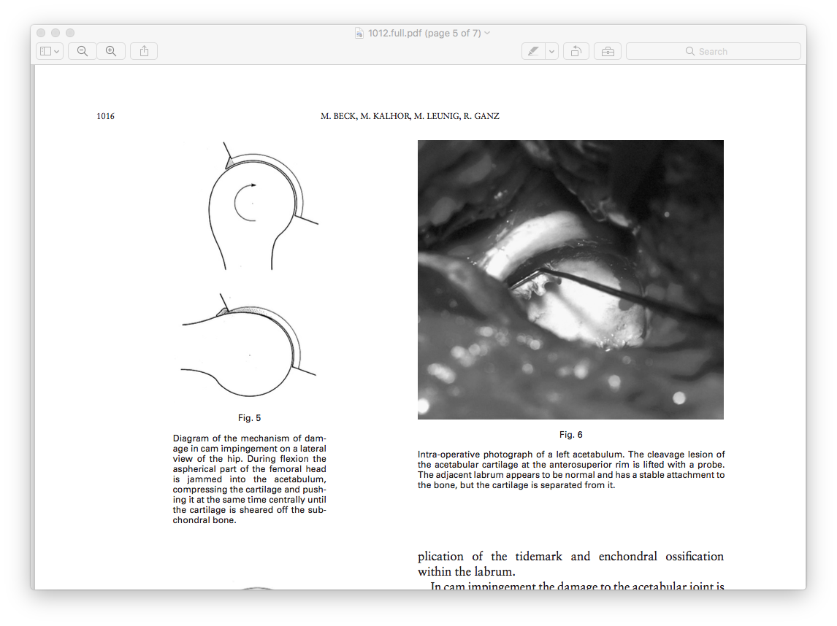
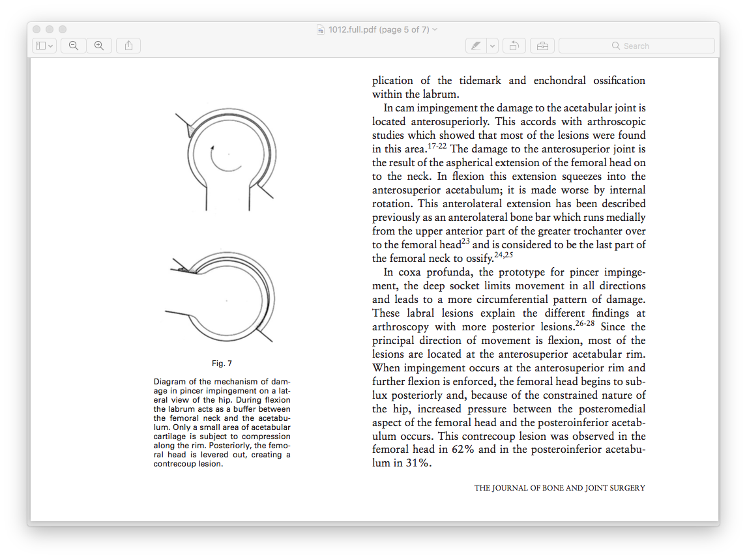
Discussion
The patterns of damage in the cam and pincer impingements differ considerably and require a different pathomechanical explanation.
Cam Pincer
Notes:
Pincer - over coverning acetabulum. At the limit of movement the femoral neck abuts against the labrum, which acts like a bumper.

Slide 18
Labral tears associated with pain due to nerve endings in the labrum
Labral tears were thought to be a cause of early hip OA
This study has shown Cam impingement leads to extensive damage to the acetabular cartilage and separation between the labrum and the cartilage. The tear of the labrum is only part of the pathology and is secondary to impingement.

Slide 19
Positives
Excellent piece of investigative work – harvest / analysis of data already collected / available
Proposes new pathological mechanism

Slide 20
Negatives
Not prospectively designed
Methods not well written
Results poorly presented

