Slide 1
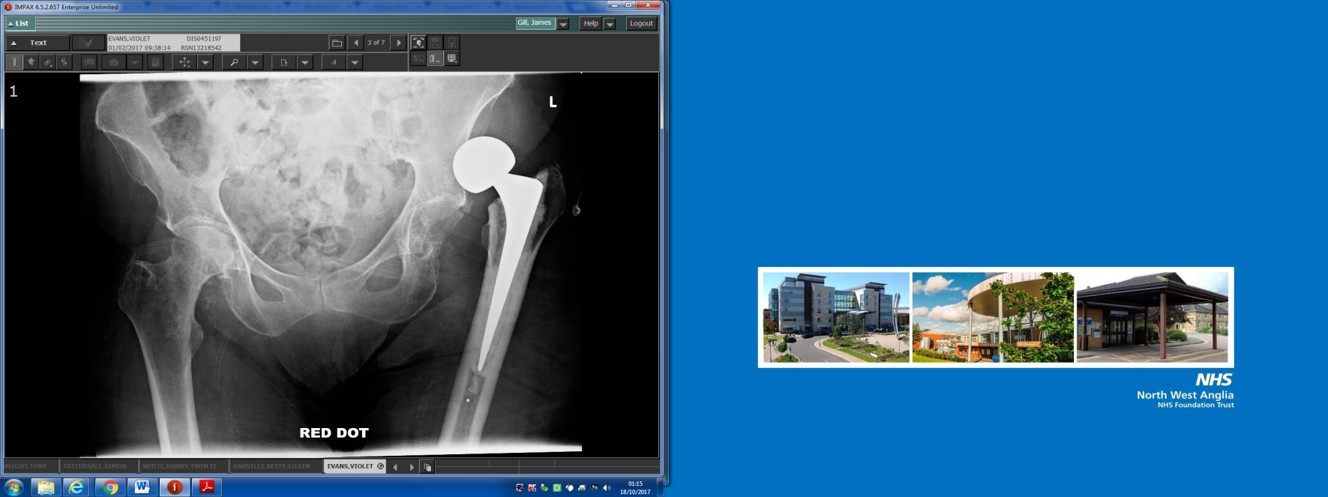
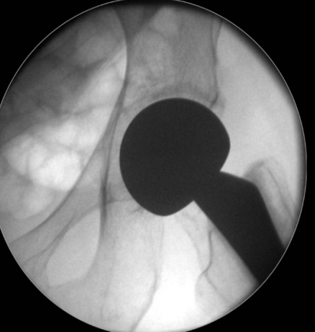
v
Management and Outcome of the dislocated hip hemiarthroplasty
Mr James Gill (ST5)
Mr Martyn Parker (Cons)
Peterborough City Hospital

Slide 2
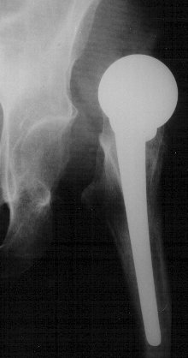
Methods
v
  3,326 hemiarthroplasties performed for hip fracture over 30 year period
  Data collected on a hip fracture database:
    - Treatment
    - Outcome at one year from hip fracture
Notes:
Analysis of prospective hip fracture database
Demographic data
Operative data: Approach, implant, cement
Complications
Further operations
Mortality
1 year pain and mobility

Slide 3
Results
v
  46/3326 (1.4%) dislocations
  Median time to dislocation 21 days
  88% of dislocations occurred within 40 days of surgery
Notes:
One case dislocated at 1959 days
Excluded for the purposes of scale of the graph

Slide 4
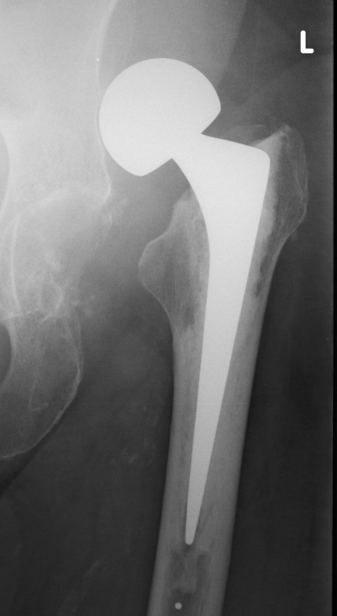
Treatment
v
  Single successful closed reduction with no further treatment required
  7/43 (16%)
  Re-dislocation rate after a closed reduction
  11/18 (61%)
Notes:
Over all 7/43 = 16%
Second closed reduction = 6/7 re dislocation rate 86%
Reason different to THA is the increased jump distance and soft tissue disruption caused by dislocation of a large hemiarthoplasty head

Slide 5
Patients divided into groups
v
  Group 1: Successful treatment
  9 Successful closed reductions
  4 Successful open reductions
  10 Successful revision arthroplasty
  Group 2: Failure of treatment
  14 Girdlestone
  3 Non-operative management*
  No dislocation
Notes:
In order to analyse meaningful numbers interventions were placed in 2 groups
Reductions 10 closed, 3 open
Revision arthroplasty 8 THA, 2 revision hemi
3 dislocations were discovered at follow up in immobile patients and were managed non operatively

Slide 6
Mortality
v
1 year mortality
26%
28%
p = 0.03
53%
Notes:
1 year mortality:
No dislocation 852/3011
Group 1 6/23
Group 2 9/17
P value two tailed fishers exact test

Slide 7
Change in mobility score
v
Notes:
Significant decline in mobility score for both group 1 and group 2

Slide 8
Able to walk
v
p = 0.01
Notes:
No significant difference in mobility between any of the groups

Slide 9
Pain score
v
Notes:
No significant difference in mobility between any of the groups

Slide 10
Take home message
v
1. Revision arthroplasty is superior to Girdlestone
Notes:
3. Reduction should not be an out of hours / junior surgeon operation as there is a significant
Revision:
Large head
Cement in cement
In rare circumstance may only require stem revision so revision hemi

Slide 11
v
1st hemiarthroplasty dislocation
Attempt closed reduction in theatre
Closed reduction achieved and hemiarthroplasty stable to EUA
No
Attempt open reduction
Yes
Mobilise with physiotherapy
Yes
Open reduction achieved and hemiarthroplasty stable to EUA
No
2nd hemiarthroplasty dislocation
Revision arthroplasty
Notes:
In order to analyse meaningful numbers interventions were placed in 2 groups
Reductions 10 closed, 3 open
Revision arthroplasty 8 THA, 2 revision hemi
3 dislocations were discovered at follow up in immobile patients and were managed non operatively

Slide 12
Take home messages
v
1. Revision arthroplasty is superior to Girdlestone
2. Primary treatment for a dislocated hemiarthroplasty is unlikely (16%) to be a ‘simple closed reduction’
3. Consider revision arthroplasty early
Notes:
3. Reduction should not be an out of hours / junior surgeon operation as there is a significant
Revision:
Large head
Cement in cement
In rare circumstance may only require stem revision so revision hemi

Slide 13

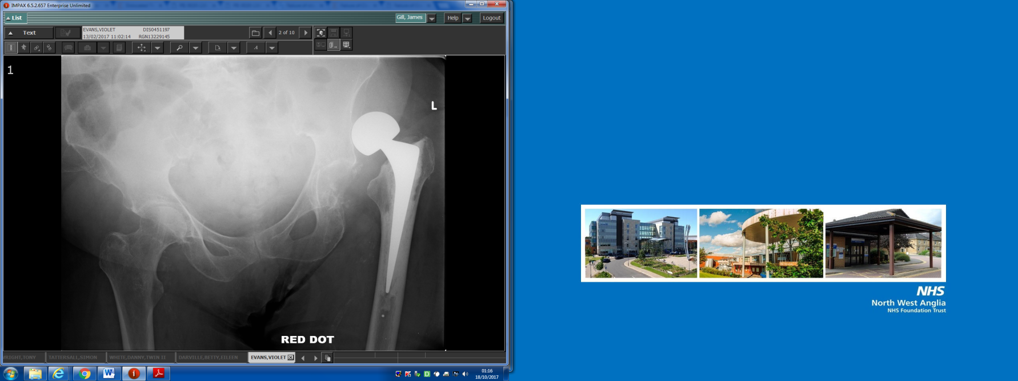
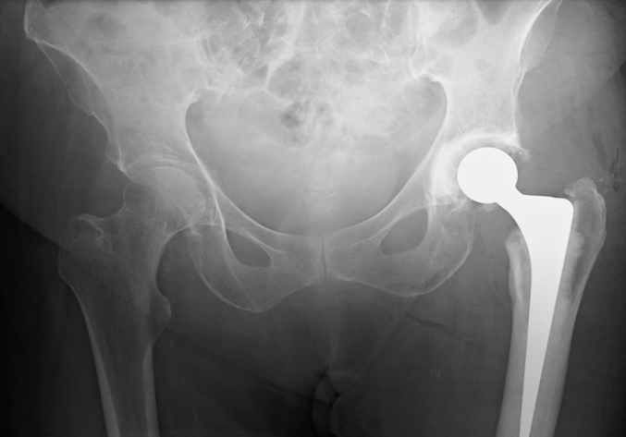
v
Questions
A
B
C
D
Notes:
Revision:
Large head
Cement in cement
In rare circumstance may only require stem revision so revision hemi

Slide 14
v
A
B
Questions?
C
D
Notes:
Revision:
Large head
Cement in cement
In rare circumstance may only require stem revision so revision hemi

Slide 15
v
 | Dislocation n=46 | No dislocation n=3280 | P-value
Patient characteristics
Mean age [range] | 83.8 [66-100] | 82.7 [45-106] | 0.32
Female (%) | 37 (80.4) | 2600 (79.3) | 1.00
From own home (%) | 29 (63.0) | 2441 (74.4) | 0.09
In institutional care (%) | 17 (37.0) | 839 (25.6)
Type of arthroplasty (% dislocation rate for implant)
Austin Moore | 12 (0.8%) | 1474 | 0.01
Thompson | 6 (1.5%) | 406 | 0.82
Exeter Trauma Stem | 20 (2.2%) | 892 | 0.02
Bipolar | 4 (4.9%) | 81 | 0.03
CPT | 3 (1.1%) | 274 | 1.00
Furlong | 1 (0.6%) | 153 | 0.72
Surgical approach (% dislocation rate for approach)
Anterior lateral | 31 (1.1%) | 2803 | 0.00
Anterior | 1 (16.7%) | 6 | 0.10
Posterior | 14 (3.7%) | 381 | 0.00
Cement (% dislocation rate for use of cement)
Cemented | 35 (2.1%) | 1677 | 0.02
Un-cemented | 11 (0.7%) | 1511
Notes:
One case dislocated at 1959 days
Excluded for the purposes of scale of the graph

Slide 16
Time to dislocation
v
n | Group 1 (≤2 closed reduction or revision arthroplasty) n=23 | n | Group 2 (excision arthroplasty or non-operative treatment) n=17
7 | Single successful closed reduction | 10 | Excision arthroplasty
4 | THA | 3 | Non-operative management
3 | Open reduction | 2 | Closed reduction, open reduction then excision arthroplasty
3 | Single closed reduction then THA
2 | Two closed reductions | 1 | Three closed reductions, THA, then excision arthroplasty
2 | Revision hemiarthroplasties
1 | Two closed reductions then THA | 1 | Closed reduction then excision arthroplasty
1 | One closed then one open reduction
Notes:
One case dislocated at 1959 days
Excluded for the purposes of scale of the graph

Slide 17
Operative Management
v

Slide 18
Operative Management
v
46
1st
Closed reduction n = 24
Open reduction n = 3
Revision hemiarthroplasty n = 2
Excision arthroplasty
n = 10
THA n = 4
Non-operative n = 3
No further
Dislocations n = 7
No further dislocations n = 2
2nd
2nd Closed reduction n = 4
THA n = 3
Excision arthroplasty n = 1
Open reduction n = 3
Missing data
n = 6
Closed reduction n = 2
No further dislocations n = 2
No further
dislocations
n = 1
THA n = 1
3rd Closed reduction n = 1
3rd
Excision arthroplasty n = 2
4th
THA n = 1
5th
Excision arthroplasty n = 1

Slide 19
Outcome Measures
v
  Pain
 | No dislocation n=2041 | Group 1 n=23 | P-value No dislocation vs. group 1 | Group 2 n=17 | P-value No dislocation vs. group 2
Mean pain score | 1.8 | 1.2 | 0.04 | 2.3 | 0.44
Mean mobility score | 4.3 | 2.9 | 0.00 | 0.33 | 0.00
Mean change in mobility score | -1.4 | -1.9 | 0.33 | -3.33 | 0.02
Not able to walk (%) | 225/2097 (10.8) | 2/14 (14.3) | 0.66 | 3/4 (75.0) | 0.01
Living in own home (%) | 1445/2090 (69.1) | 11/17 (64.7) | 0.79 | 1/6 (16.7) | 0.01

Slide 20
Patients divided into groups
v
  Group 1: Successful treatment (84.6)
  9 Successful closed reductions (7 1º, 2 2º)
  4 Successful open reductions (3 primary, 1 post CR)
  10 Successful revision arthroplasty (4x 1º THA, 3 post CR, 1 post 2x CR, 2 revision hemis )
  Group 2: Failure of treatment (83.2)
  14 Girdlestone (10 1º, 1x 2nd, 2x 3rd & 1x 5th)
  3 Non-operative management*
  No dislocation
Notes:
In order to analyse meaningful numbers interventions were placed in 2 groups
Reductions 10 closed, 3 open
Revision arthroplasty 8 THA, 2 revision hemi
3 dislocations were discovered at follow up in immobile patients and were managed non operatively

Slide 21
Change in mobility score
v
 | No difficulty and no aid | With a walking aid | With help from another person | Not at all
Able to get about the house (indoor walking) | 3 | 2 | 1 | 0
Able to get out of the house (outdoor walking) | 3 | 2 | 1 | 0
Able to go shopping (walking during shopping) | 3 | 2 | 1 | 0
Mobility was assessed using a scale of 0 to 9. Nine represents full mobility indoors and outdoors without walking aids; Zero represents a bed-bound patient.
Notes:
In order to analyse meaningful numbers interventions were placed in 2 groups
Reductions 10 closed, 3 open
Revision arthroplasty 8 THA, 2 revision hemi
3 dislocations were discovered at follow up in immobile patients and were managed non operatively

Slide 22
Pain score
v
Notes:
In order to analyse meaningful numbers interventions were placed in 2 groups
Reductions 10 closed, 3 open
Revision arthroplasty 8 THA, 2 revision hemi
3 dislocations were discovered at follow up in immobile patients and were managed non operatively

Slide 23
Living in own home
v
p = 0.01
Notes:
No significant difference in mobility between any of the groups

Slide 24
Revision technique
v
Dual taper polished stem
Allows cement in cement revision
Larger head
Same approach
Consider revision of stem alone if stem version is the issue
Coomber et al

