Slide 1
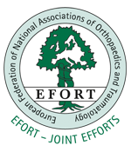
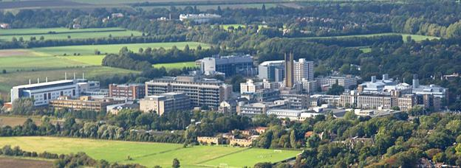

The Management of Severe Open Lower Limb Fractures
Audit of the complete BOAST 4 standards: 1st 12 months of Cambridge University Hospitals as a Major Trauma Centre
James Gill and Suzanne Murphy,
Peter Hull and David Wallace

Slide 2
Disclosure
In relation to this presentation, I declare that there are no conflicts of interest.
* A conflict of interest is any situation in which a speaker or immediate family members have interests, which may cause a conflict with the current presentation. Conflicts of interest do not preclude the delivery of the talk, but should be explicitly declared. These may include financial interests (e.g. owning stocks of a related company, having received honoraria, consultancy fees), research interests (research support by grants or otherwise), organisational interests and gifts.

Slide 3
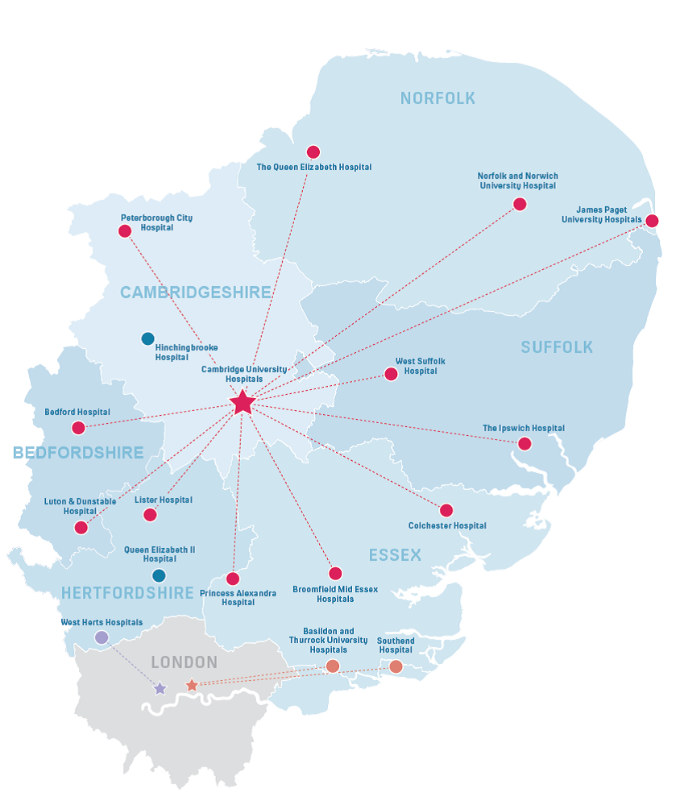
East of England Trauma Network
6 counties
5.9 million population
1298 pts/yr ISS>8
590 pts/yr ISS>15
12 Trauma Units
1 MTC – live April 2012

Slide 4


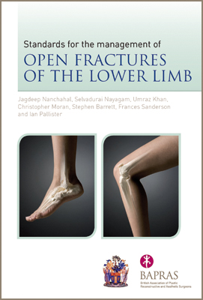
BOAST 4 = 15 standards
Aim:
  Determine compliance with all 15 BOAST 4 standards in the first 12 months as a MTC
Methods:
  TARN office data
  1st April 2012 – 31st March 2013
  Open lower limb fracture meeting BOAST 4 criteria included
Notes:
Methods:
1st April 2012 – 31st March 2013
Open lower limb fractures meeting BOAST 4 inclusion criteria identified
Reviewed all patients records (paper and electronic)

Slide 5
Results
44 cases over 12 month period, 16 excluded = 28 included
Exclusions
Gustilo-Anderson Grade

Slide 6
Snapshot of Overall BOAST 4 Compliance
%

Slide 7
Appropriate IV antibiotics
Antibiotics
%
Dressings
Usage of dressing during emergency management
%
Notes:
Antibiotics: In 7 of the 28 cases antibiotics were given pre-hospital
STANDARD 7: The wound is handled only to remove gross contamination and to allow photography, then covered in saline-soaked gauze and an impermeable film
Photographs were present in only 11 of 28 of the case notes

Slide 8
Fracture Fixation and Wound Cover
Compliance with achieving definitive skeletal stabilisation & wound cover within 72hrs & no longer than 7 days
%
* Excluding clinically indicated surgical delay

Slide 9
Conclusions & Recommendations
Areas for improvement:
  Photographing wounds
  Dressings
  Correct antibiotics on induction
  Skeletal stabilisation & wound cover within 3 days
Recommendations:
  Plastic surgery team member present at open fracture trauma calls
  Plastic surgery SHO to attend morning trauma meeting
  Operation note proforma
  The author declares that the research for and communication of this independent body of work does not constitute any financial or other conflict of interest
The author declares that the research for and communication of this independent body of work does not constitute any financial or other conflict of interest.
Notes:
Achieving definitive skeletal stabilisation and wound cover within 3 days will be more challenging and require:
Restructuring of theatre lists
Closer orthoplastic multidisciplinary team working
If compliance to the guidelines are to be used for financial remuneration: intense study of clinically indicated breaches will need to be undertaken: See poster
To aid documentation of steps and prompt next steps in management

