Slide 1
Anatomy of the Calcaneum
10th September 2015
James Gill ST3

Slide 2
Content
Bony anatomy
Blood supply
X-ray appearances

Slide 3
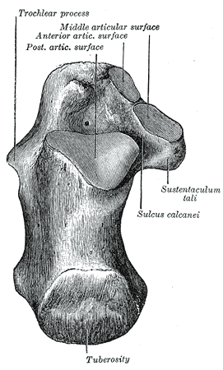
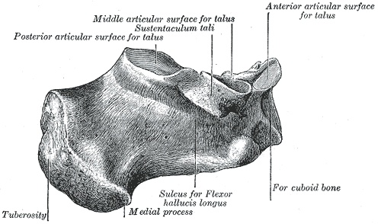
Superior & Medial Surfaces
Notes:
Irregularly cuboidal shaped bone
Superior surface:
The most posterior 1/3 is rough and concavo-convex.
The middle 1/3 carries the posterior talar facet.
The anterior 1/3 is partly articular. Anterior to the articular region of the posterir talar facet, there is a rough depression leading to a groove, the sulcus calcanei, on the medial side. The sulcus calcanei completes the sinus tarsi with talus.
Medial surface:
Concave.
The sustantaculum tali projects distally from the distal part of its upper border. Superiorly, the process bears the middle talar facet and inferiorly a groove for flexor hallucis longus (contnuous with that on the talar posterior surface for the tendon of)

Slide 4
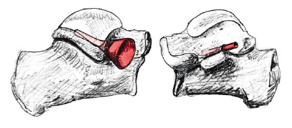
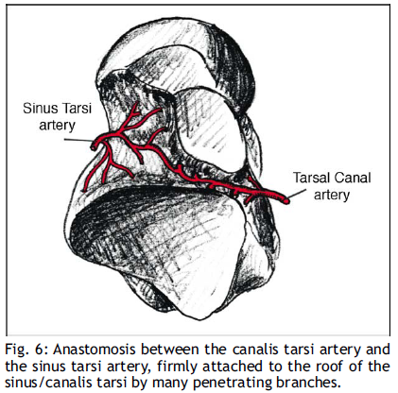
Sinus tarsi and canal tarsi
Notes:
The space between the talus and the calcaneus is like a funnel. The sinus tarsi is the “cone” between the neck, the lateral process of the talus, and the anterior process of the calcaneus (Fig. 10).
This funnel ends in the canal tarsi (the tube) where the sinus tarsi artery anastomoses with the tarsal canal artery.

Slide 5
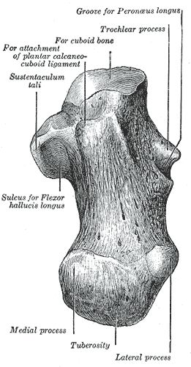
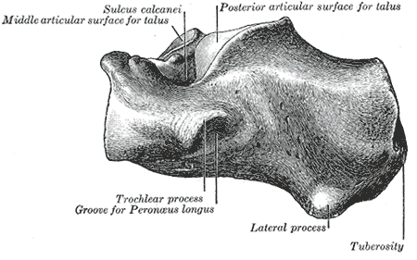
Lateral & plantar surfaces
Notes:
Lateral surface:
It is almost flat and palpable on the lateral aspect of heel.
Distally, it presents the trochlear process.
There is a deep groove for tendon of peroneus longus and a shallow groove for tendon of peroneus brevis.
Attachement of calcaneal-fibular ligament.
Plantar surface:
It is rough and forms the calcaneal tuberosity proximally. There are two laterally extending processes, separated by a notch.
Anterior surface:
Obliquely set articular facet for the cuboid bone.

Slide 6
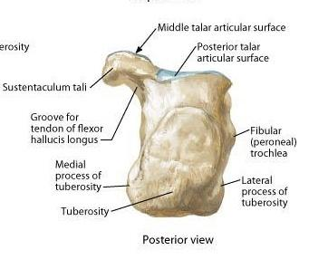
Posterior Surface
Notes:
Posterior surface:
Calcaneal tendon insertion middle portion of posterior surface.
Lower 1/3 of posterior surface, the calcaneal tuberosity is the subcutaneous weight-bearing surface.

Slide 7
Animation
https://upload.wikimedia.org/wikipedia/commons/e/e1/Left_Calcaneus_animation03.gif

Slide 8
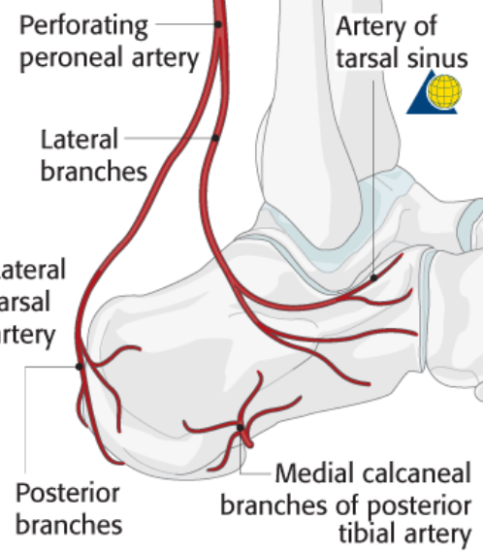
Perforating peroneal artery
Notes:
The three main arteries of the ankle (anterior and posterior tibial arteries and the peroneal artery) produce many branches of the vascular network of the calcaneum.
Sinus tarsi artery

Slide 9
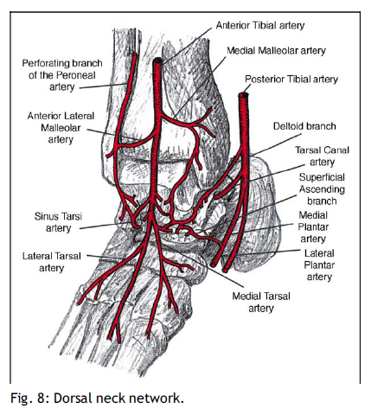
Anterior tibial artery
Notes:
Anterior tibial artery:
Below the talocrural joint, it becomes the dorsalis pedis artery, which gives rise to many branches over the neck of the Talus.
Laterally dorsalis pedis anastomoses with the sinus tarsi artery
Medial side with branches of the posterior tibial artery including the medial plantar artery.

Slide 10
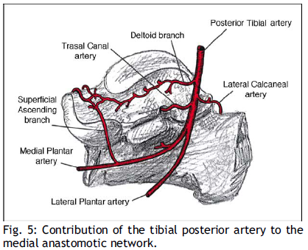
Arterial blood supply
Notes:
Posterior tibial artery:
Anterior deltoid branch
Posterior branch lateral calcaneal artery
Anterior branch – tarsal canal artery
Divides into medial and lateral plantar arteries

Slide 11
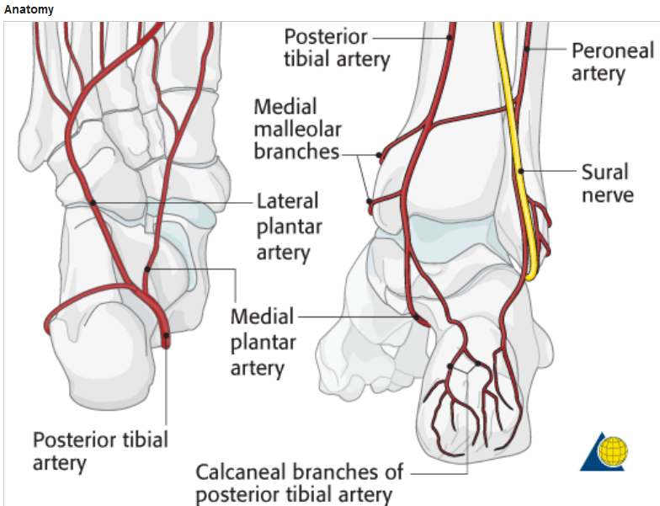
Posterior tibial artery and peroneal artery
Lateral calcanealartery

Slide 12
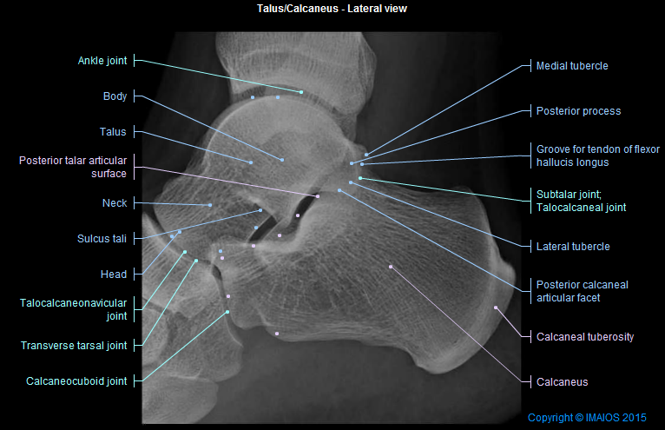
Lateral radiograph
Sustentaculum tali

Slide 13
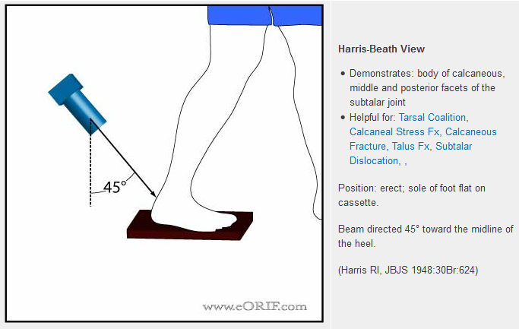
Harris View

Slide 14
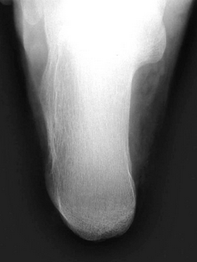
Harris View

Slide 15
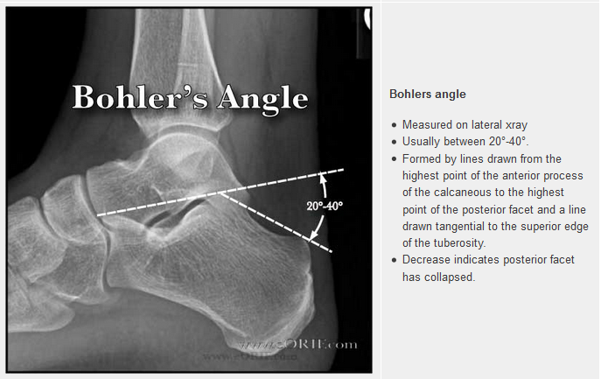
Bohlers Angle

Slide 16
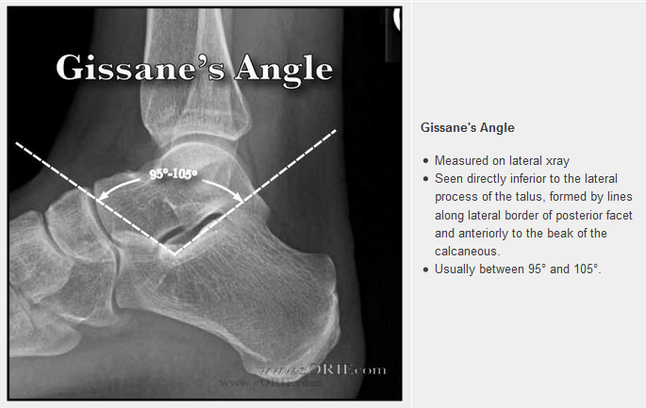
Gissane’s Angle
Notes:
Increase indicates collapse of the posterior facet

Slide 17
Questions

Slide 18
References
AO
eORIF
Central talar fractures—therapeutic considerations. Patrick Cronier, Abdelhafid Talha, Philippe Massin. Injury, Int. J. Care Injured (2004) 35, S-B10—S-B22 (blood supply)
Grey’s Anatomy (pictures)
Essential anatomy 3D (app)

Slide 19
Appendix

Slide 20
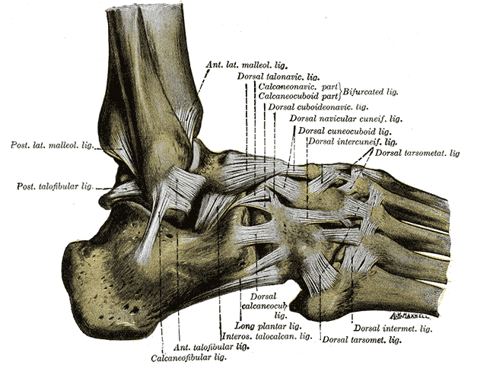
Appendix

Slide 21
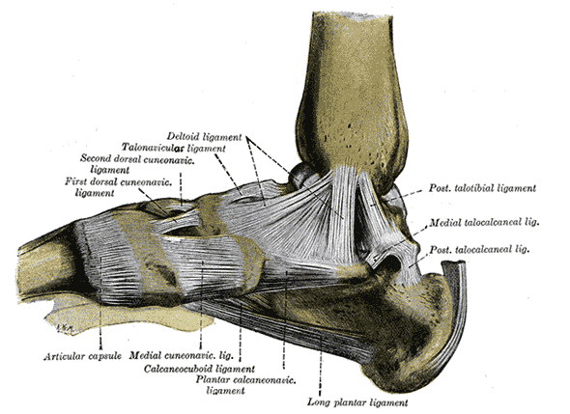

Slide 22
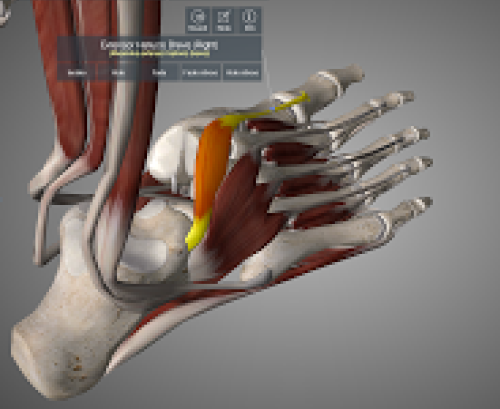
EHB & EDB

Slide 23
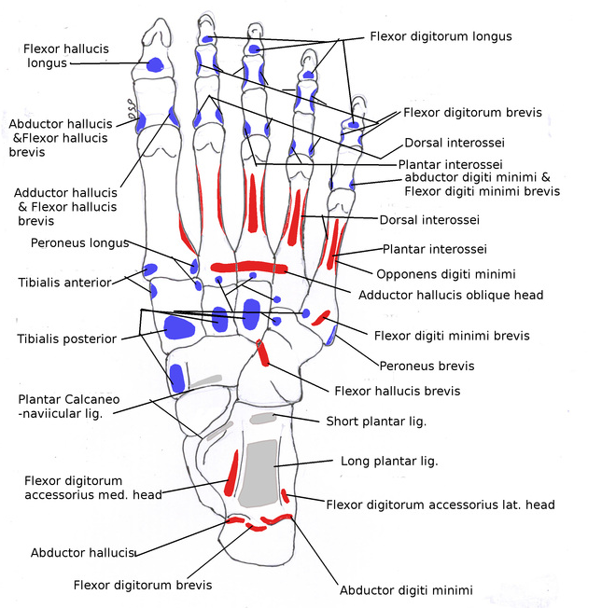

Slide 24
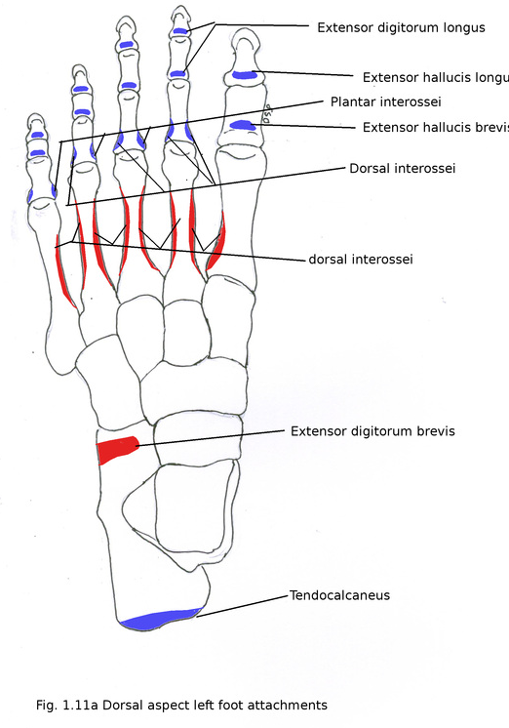

Slide 25
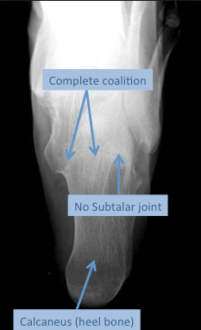
Sub talar coalition on Harris’ view

