Slide 1

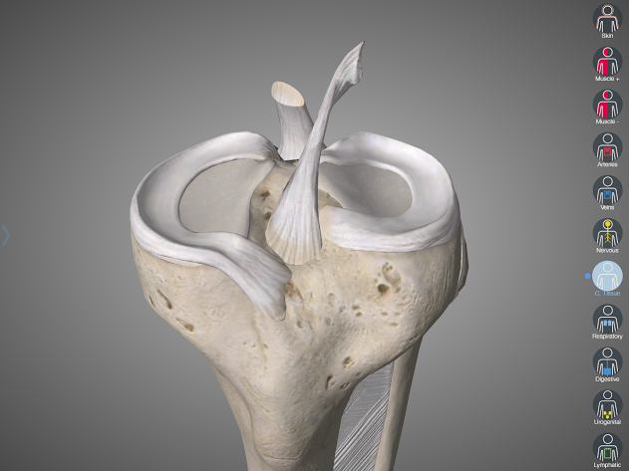
ACL
West Suffolk Hospital Journal Club
Thursday 28th January
Anatomy
Function
Clinical tests
ACL
With thanks to Linvatec
James Gill ST3

Slide 2
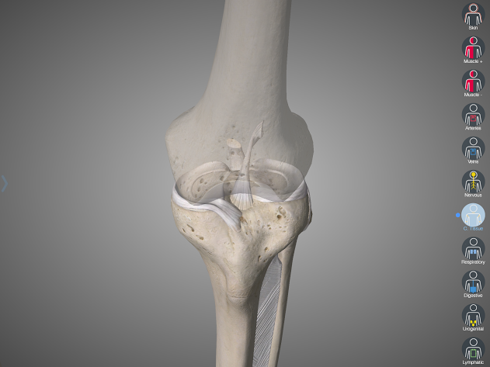
ACL Anatomy
Notes:
The ACL is a ligamentous structure composed of dense connective tissue containing parallel rows of fibroblasts and type I collagen
Length of 38 mm (range 25 to 41 mm)
Width of 10 mm (range 7 to 12 mm)

Slide 3
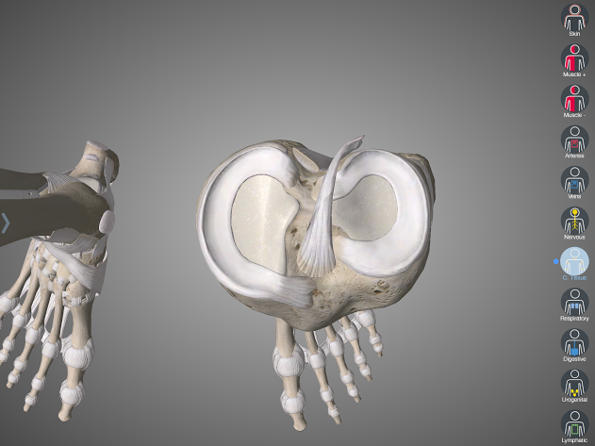
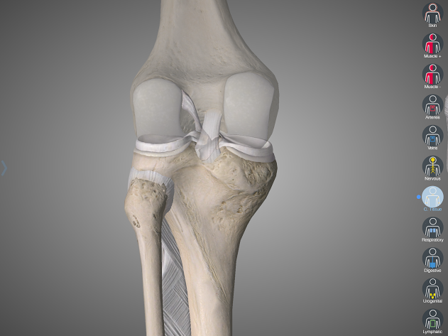
Introduction to Anatomy
v
Notes:
ORIGIN: Posterior medial aspect of the lateral femoral condyle (113mm2)
INSERTION: Anterior and lateral aspect of the medial tibial spine (136mm2)
Anatomic centrum of the ACL femoral footprint is 43% of the proximal-to-distal length of lateral, femoral intercondylar notch wall and femoral socket radius plus 2.5 mm anterior to the posterior articular margin

Slide 4
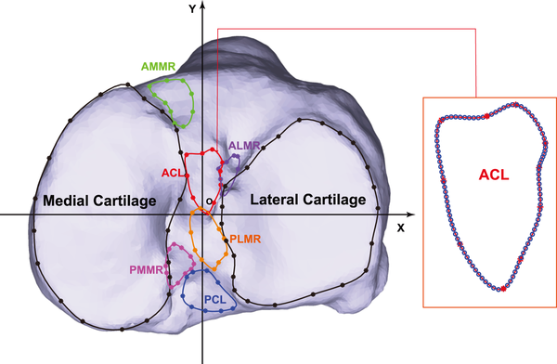
ACL Anatomy
v
ACL tibial footprint

Slide 5
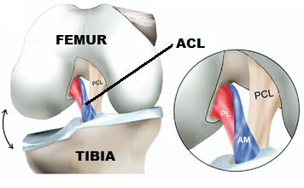
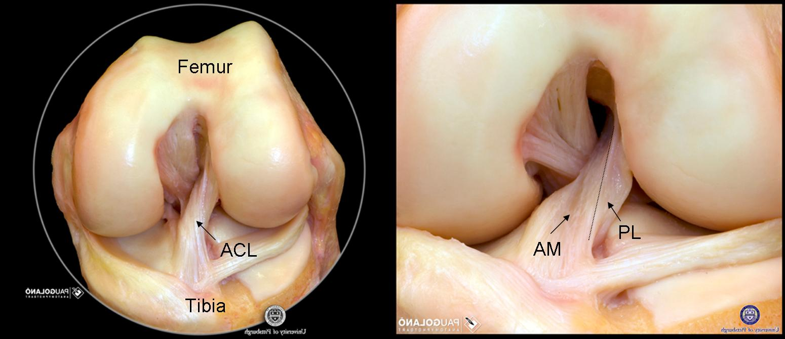
Double bundle (7, 8)
v
PL
AM
Notes:
The ACL does not function as a simple tube of fibres with a constant tension.
There are two portions to the ACL and they are named for the place where they attach to the tibia.
Anteromedial bundle and the posterolateral bundle.

Slide 6
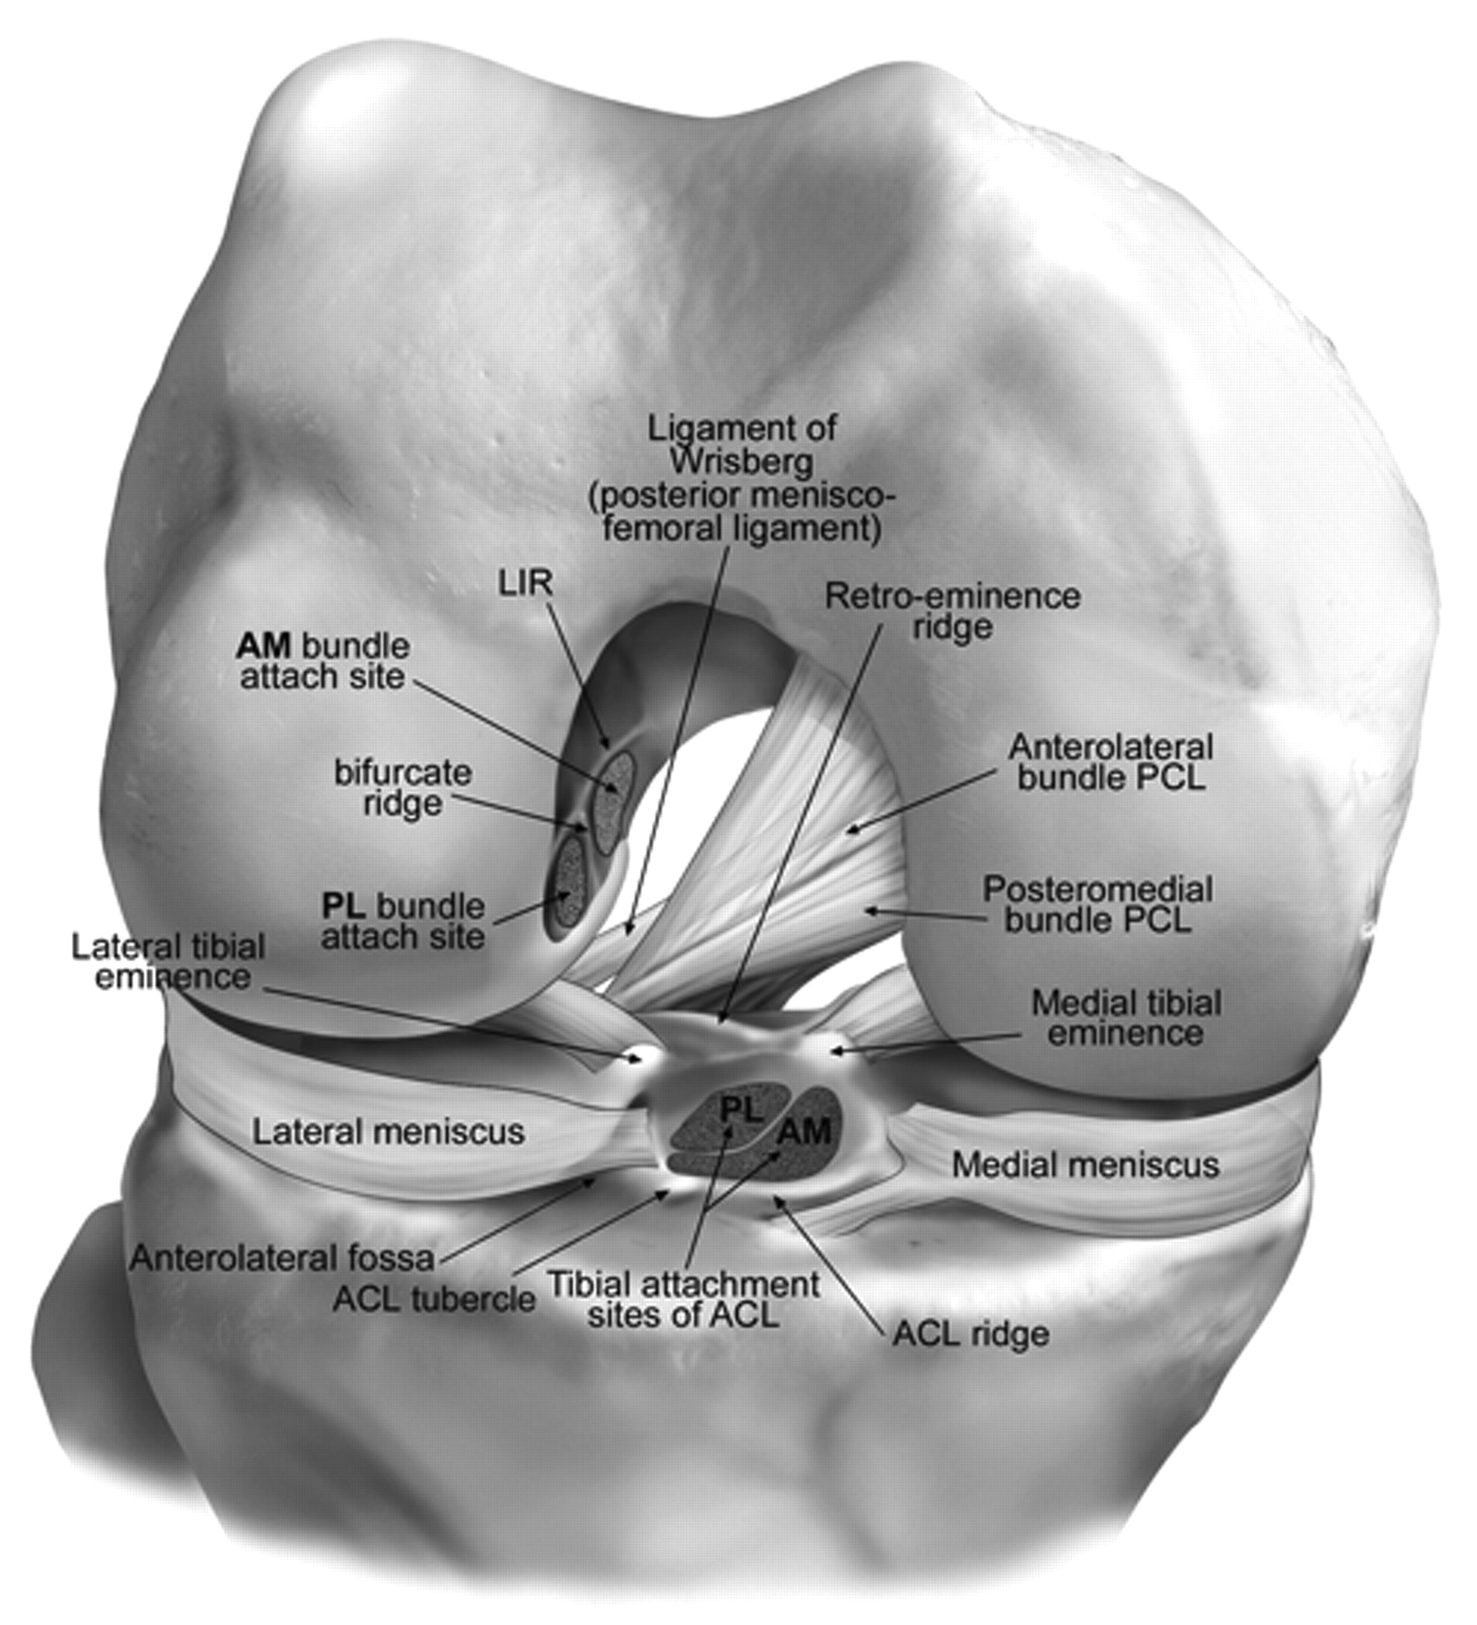
Double bundle
v
PL
AM
Notes:
The ACL does not function as a simple tube of fibres with a constant tension.
There are two portions to the ACL and they are named for the place where they attach to the tibia.
They are the Anteromedial bundle and the Posterolateral bundle.

Slide 7
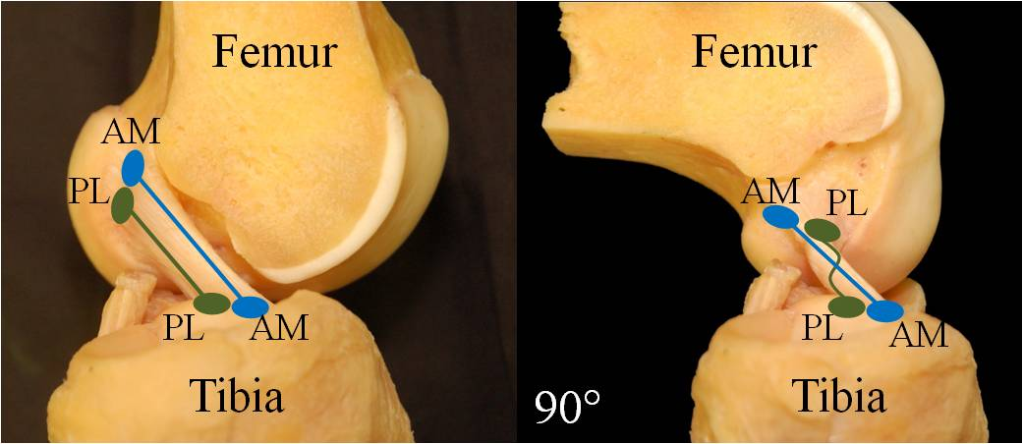
Double bundle
.
Notes:
Each bundle acts differently to stabilize the knee.
Both the AM and PL bundle are parallel with the knee extended.
Providing stability in the anterior direction (PL under greater tension in knee extension).
PL bundle is also important in providing rotational stability.
As the knee flexes the AM bundle tightens and the PL bundle slackens winding around the AM.
(9) Transection of the anteromedial bundle increased anterior tibial translation at 60 degrees and 90 degrees of knee flexion significantly. Isolated transsection of the posterolateral bundle increased anterior tibial translation in response to 134-N anterior load at 30 degrees of knee flexion significantly and resulted in a significant increase in combined rotation at 0 degrees and 30 degrees in response to a combined rotatory load compared with the intact knee and isolated resection of the anteromedial bundle.

Slide 8
ACL function
v
The ACL is the predominant restraint to anterior tibial displacement
The ACL may act as a restraint to internal rotation (there is a medial shift of the rotation axis in the ACL-deficient knee)
Notes:
The function of a ligament is to resist movement by resisting elongation caused by that movement, which may be rotational, translational or both. To understand the function of a ligament during a rotational movement, some consideration must be given to the relationship of the ligament to the axis of rotation. It is fundamental then to understand normal knee kinematics and ACL behaviour during knee motion.
(10) There is no clear understanding of the function of the ACL beyond a role in restricting anterior motion of the tibia, and any brief statement of function either does not aspire to great accuracy or claims unwarranted certainty. Without doubt the ligament opposes anterior translation in response to an anterior force, but any effect on internal tibial rotation, especially about a centrally-placed axis, appears small and variable. Perhaps if injury to the ACL were not quite so frequent and/or disabling the discussion might end there. But less than ideal outcomes from reconstructive surgery, and an association of poor outcomes and a positive pivot shift test, indicate an issue with rotational stability.

Slide 9
Native ACL tensile strength
v
Tensile strength of the native femur-ACL-tibia (bone-ligament-bone) complex:
  2160 +/- 157 N in young cadaveric specimens (1, 2)
  496+/-85 N in older specimens (3)

Slide 10
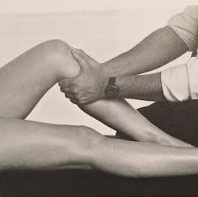
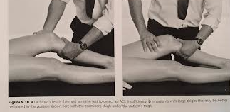
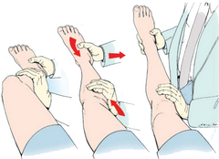
Clinical Tests
v
Anterior draw test (@90º) • Lachman’s (@15º) (4)
Pivot shift test (5, 6)
              1. Leg fully extended
              2. Internally rotate lower leg & valgus stress to knee
              3. Slowly flex knee
1 2 3
Notes:
Anterior draw test:
Knee flexed to 90 degrees, foot fixed to couch.
Grasp the upper tibia with both hands with thumbs on the tibial tubercles.
At this angle of flexion the tibia should be anterior to the femoral condyle.
(* make sure hamstrings are relaxed, assess for posterior sag)
Lachman’s more reliable for ACL instability:
Advantages over anterior draw according to original Lachman paper
More comfortable position
Do not have to fight hamstrings at 10 degrees of flexion
Medial joint capsule (in flexion) and congruency of posterior aspect of medial femoral condyle with medial meniscus prevent anterior translation of medial meniscus unless, tear to medial joint capsule and posterior horn of medial meniscus
Pivot shift test:
Assesses rotational instability.
Recreates anterolateral subluxation of the tibia on the femur, which results in a giving way sensation when twisting on a planted foot.
Leg fully extended
Lower leg internally rotated, valgus strain applied – In this position the tibia is anterolaterally subluxed.
Knee then flexed gently and at about 20 degrees the tibia suddenly reduced.
Usually under anaesthetic
Tibia rotates anteriorly about the axis of the taught MCL (under valgus stress), intact ACL would usually resist anterior subluxation of lateral tibia.
Mechanism of the pivot shift:
A valgus torque on the knee produces a tensile load along the MCL and a compressive one on the lateral side.
When the knee is subjected to a valgus torque and lower leg internally rotated the lateral tibia experiences an anterior force. An intact ACL resists this force preventing the lateral tibia from subluxing anteriorly.
In an ACL-deficient knee, the lateral tibial plateau subluxes anteriorly, and the tibia rotates internally about a tight MCL
As the knee is flexed further, the tension in an intact ITT, relocates the tibia.

Slide 11
References
v
1. Woo SL, Debski RE, Withrow JD, Janaushek MA (1999) Biomechanics of knee ligaments. Am J Sports Med 27:533–543
2. Woo SL, Hollis JM, Adams DJ et al (1991) Tensile properties of the human femur-anterior cruciate ligament-tibia complex. The effects of specimen age and orientation. Am J Sports Med 19:217–225
3. Noyes FR, Butler DL, Grood ES et al (1984) Biomechanical analysis of human ligament grafts used in knee-ligament repairs and reconstructions. J Bone Joint Surg Am 66:344–352
4. Torg JS, Conrad W, Kalen V. Clinical Diagnosis of ACL ligmanet instability in Athletes. Am J. Sports Med 1976: 4:84-93
5. Galway HR, MacIntosh DL. The lateral pivot shift: a symptom and sign of anterior cruciate ligament instability. Clin Orthop 1980; 147: 45-50
6. Matsumoto. Mechanism of the pivot shift test. Japan. JBJS (Br) 1990
7. http://www.performanceorthosports.com/DOUBLEBUNDLEACL.html
8. http://www.orthonet.pitt.edu/content/DoubleBundle.htm
9. Zantop T1, Herbort M, Raschke MJ, Fu FH, Petersen W. The role of the anteromedial and posterolateral bundles of the anterior cruciate ligament in anterior tibial translation and internal rotation. Am J Sports Med. 2007 Feb;35(2):223-7. Epub 2006 Dec 7.
10. Christopher D. S. Jones¹ and Paul N. Grimshaw² The Biomechanics of the Anterior Cruciate Ligament and Its Reconstruction. Orthopedics, Physical Medicine and Rehabilitation "Theoretical Biomechanics", book edited by Vaclav Klika, ISBN 978-953-307-851-9, November 25, 2011

Slide 12
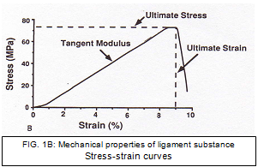
Appendix 1 – Mechanical Properties of a ligament
Notes:
“Classification of pelvic fractures has been considered the keystone of deciding management” Burgess 1990
Longstanding controversy surrounding the management of APC II pelvic injuries

Slide 13
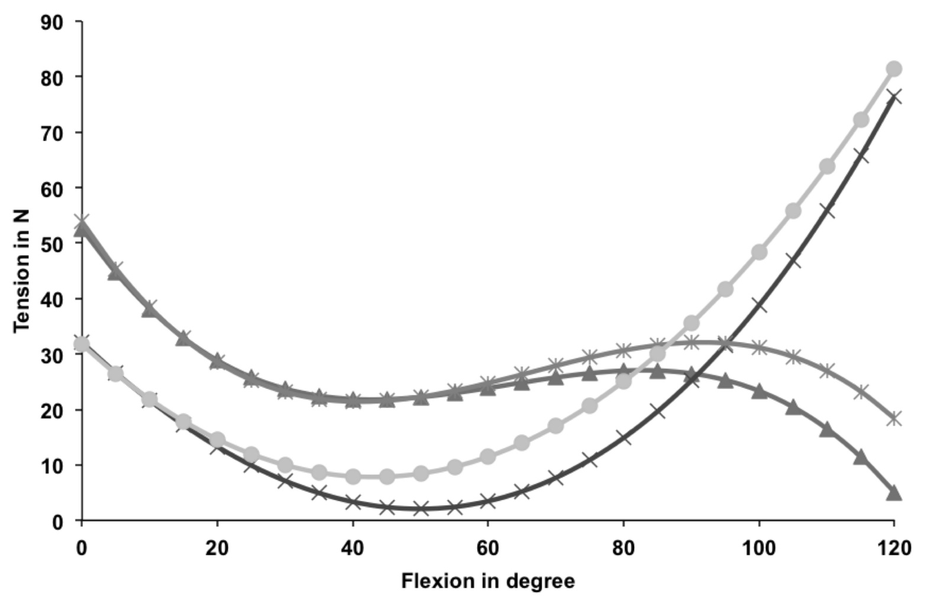
Appendix 1 – Graph AM & PL tension vs. Knee flexion
PL
AM

