Slide 1
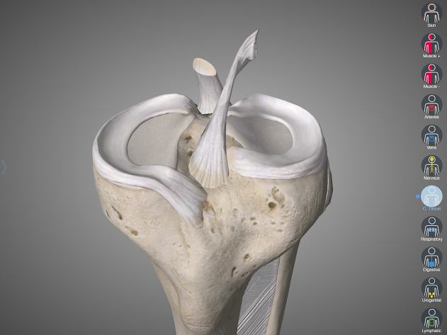
ACL
ACL graft healing
Early healing phase
Proliferative
Ligamentization
Graft
James Gill T&O SpR

Slide 2
Patient questions
v
  “When will my ACL have healed?”
  “How does it heal?”
  “Will it be normal again”
  “When can I return to sport?”

Slide 3
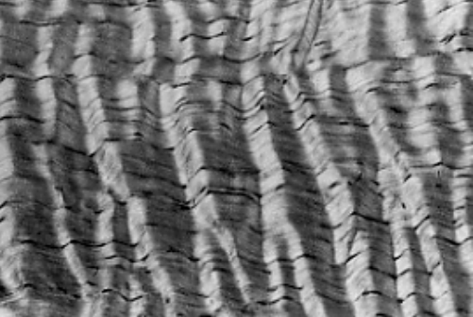
Tendons versus ligaments
v
 | Ligament | Tendon
Collagen | 70-80% dry weight | Slightly more
Collagen orientation | Crimped Slightly more random orientation | Larger fibers than in ligament Parallel orientation
Elastin | Higher elastin content than tendons | Scarce
Crimping pattern of collagen in ligament

Slide 4
Adaptation
Like muscles soft-tissue structures, such as ligaments and tendons, undergo specific changes in their mechanical and biological properties, when they are exposed to a different mechanical loading and biological environment
ACL grafts undergo a process of adaptation rather than full restoration of the intact ACL’s biological properties
Like muscles, soft-tissue structures, such as ligaments and tendons, undergo specific changes in their mechanical and biological properties, when they are exposed to a different mechanical loading and biological environment
Notes:
ACL grafts undergo a process of adaptation rather than full restoration of the intact ACL’s biological properties

Slide 5
3 phases of healing
Early healing phase
Proliferative healing phase
Ligamentization
Early healing phase
Proliferative healing phase
Ligamentization
Notes:
Continum rather than discrete phases (so timijngs vary)
Much of the evidence comes from animal models: allowing for biopsies and mechanical tests to failure

Slide 6
1. Early healing phase
Early healing phase
Proliferative healing phase
Overview: Cell necrosis (~30% of cells)
Timing: 0-4 weeks
Macroscopic graft swelling
Influx of new cells replacing original graft cells
Initially collagen structure maintained so only slow decrease in mechanical properties
Notes:
Cell necrosis 100% in animal models less in humans

Slide 7
2. Proliferation & revascularisation
Overview: Maximum cellular activity & revascularisation
Time: 4th – 12th week
Collagen fibril density decreases and returns to values of an intact ACL at 12 weeks (Collagen III)
Mechanical properties reach a minimum at ~ 6-8 weeks
Notes:
Cellularity constantly increases and temporarily surpassing that of the intact ACL
Cells release growth factors resulting in tissue remodelling
Necrosis and hypoxia of the early healing phase leads to intense revascualrisation initially from the perimeter of the graft towards its entire diameter
Increase cellularity, revascularisation and loss of regular collagen orientation results in

Slide 8
Ligamentization
Early healing phase
Proliferative healing phase
Overview: Continuous remodelling towards the morphology of the intact ACL
Time: 3 - 6+ months
Cellularity returns to values of intact ACL 3-6 months
Vascularity decreases and returns to values of intact ACL 6-12 months
Mechanical properties of reconstructed ACL reach maximum ~ 1 year (still only ~ 50—60% of the intact ACL)
Differences remain and explain lower mechanical properties of the healing ACL = adaption rather than full restoration of the ACLs biological properties
Notes:
No clear end point to ligamentization – remodeling continues for years
It has also been
shown in rabbit, dog and sheep models [3 , 30 , 51 , 52 ] for
certain extra-cellular matrix proteins, such as glycosaminoglycans,
and collagen cross-links, that the healing graft
undergoes a transformation from its initial tissue properties,
e.g., a patellar tendon or free soft-tissue tendon graft,
to properties of the intact ACL during this ligamentization
phase [3 , 30 ] as early as 6 months.
Differences remain – small collagen fibres opposed to The heterogeneous
composition of collagen fibers of varying diameter of the
intact ACL is never restored
Increased type III collagen (lower mechanical strength than type I collagen) type III collagen levels may fall over years – 3 yr in animal models

Slide 9
Rehabilitation
Early healing phase
Proliferative healing phase
Overloading can lead to impaired graft healing
however….
depriving the graft of any stress accelerated deterioration of mechanical strength
The optimal magnitude of mechanical loading during varying phases of healing is unknown!

Slide 10
Rehab
Early healing phase
Proliferative healing phase
What guides ligamentisation:
Restoration of knee joint mechanics (restore anatomy) so that the same mechanical stimulus is applied to the healing ACL as to the intact ACL
Optimal loading?
Notes:
What loading is optimal for the graft at different phases of healing?

Slide 11
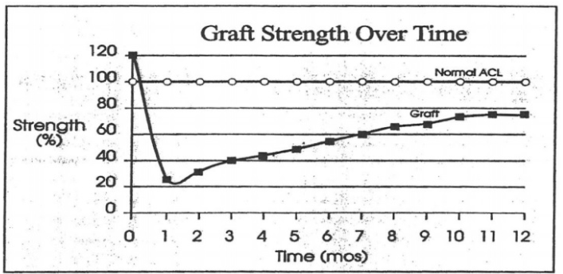

Slide 12
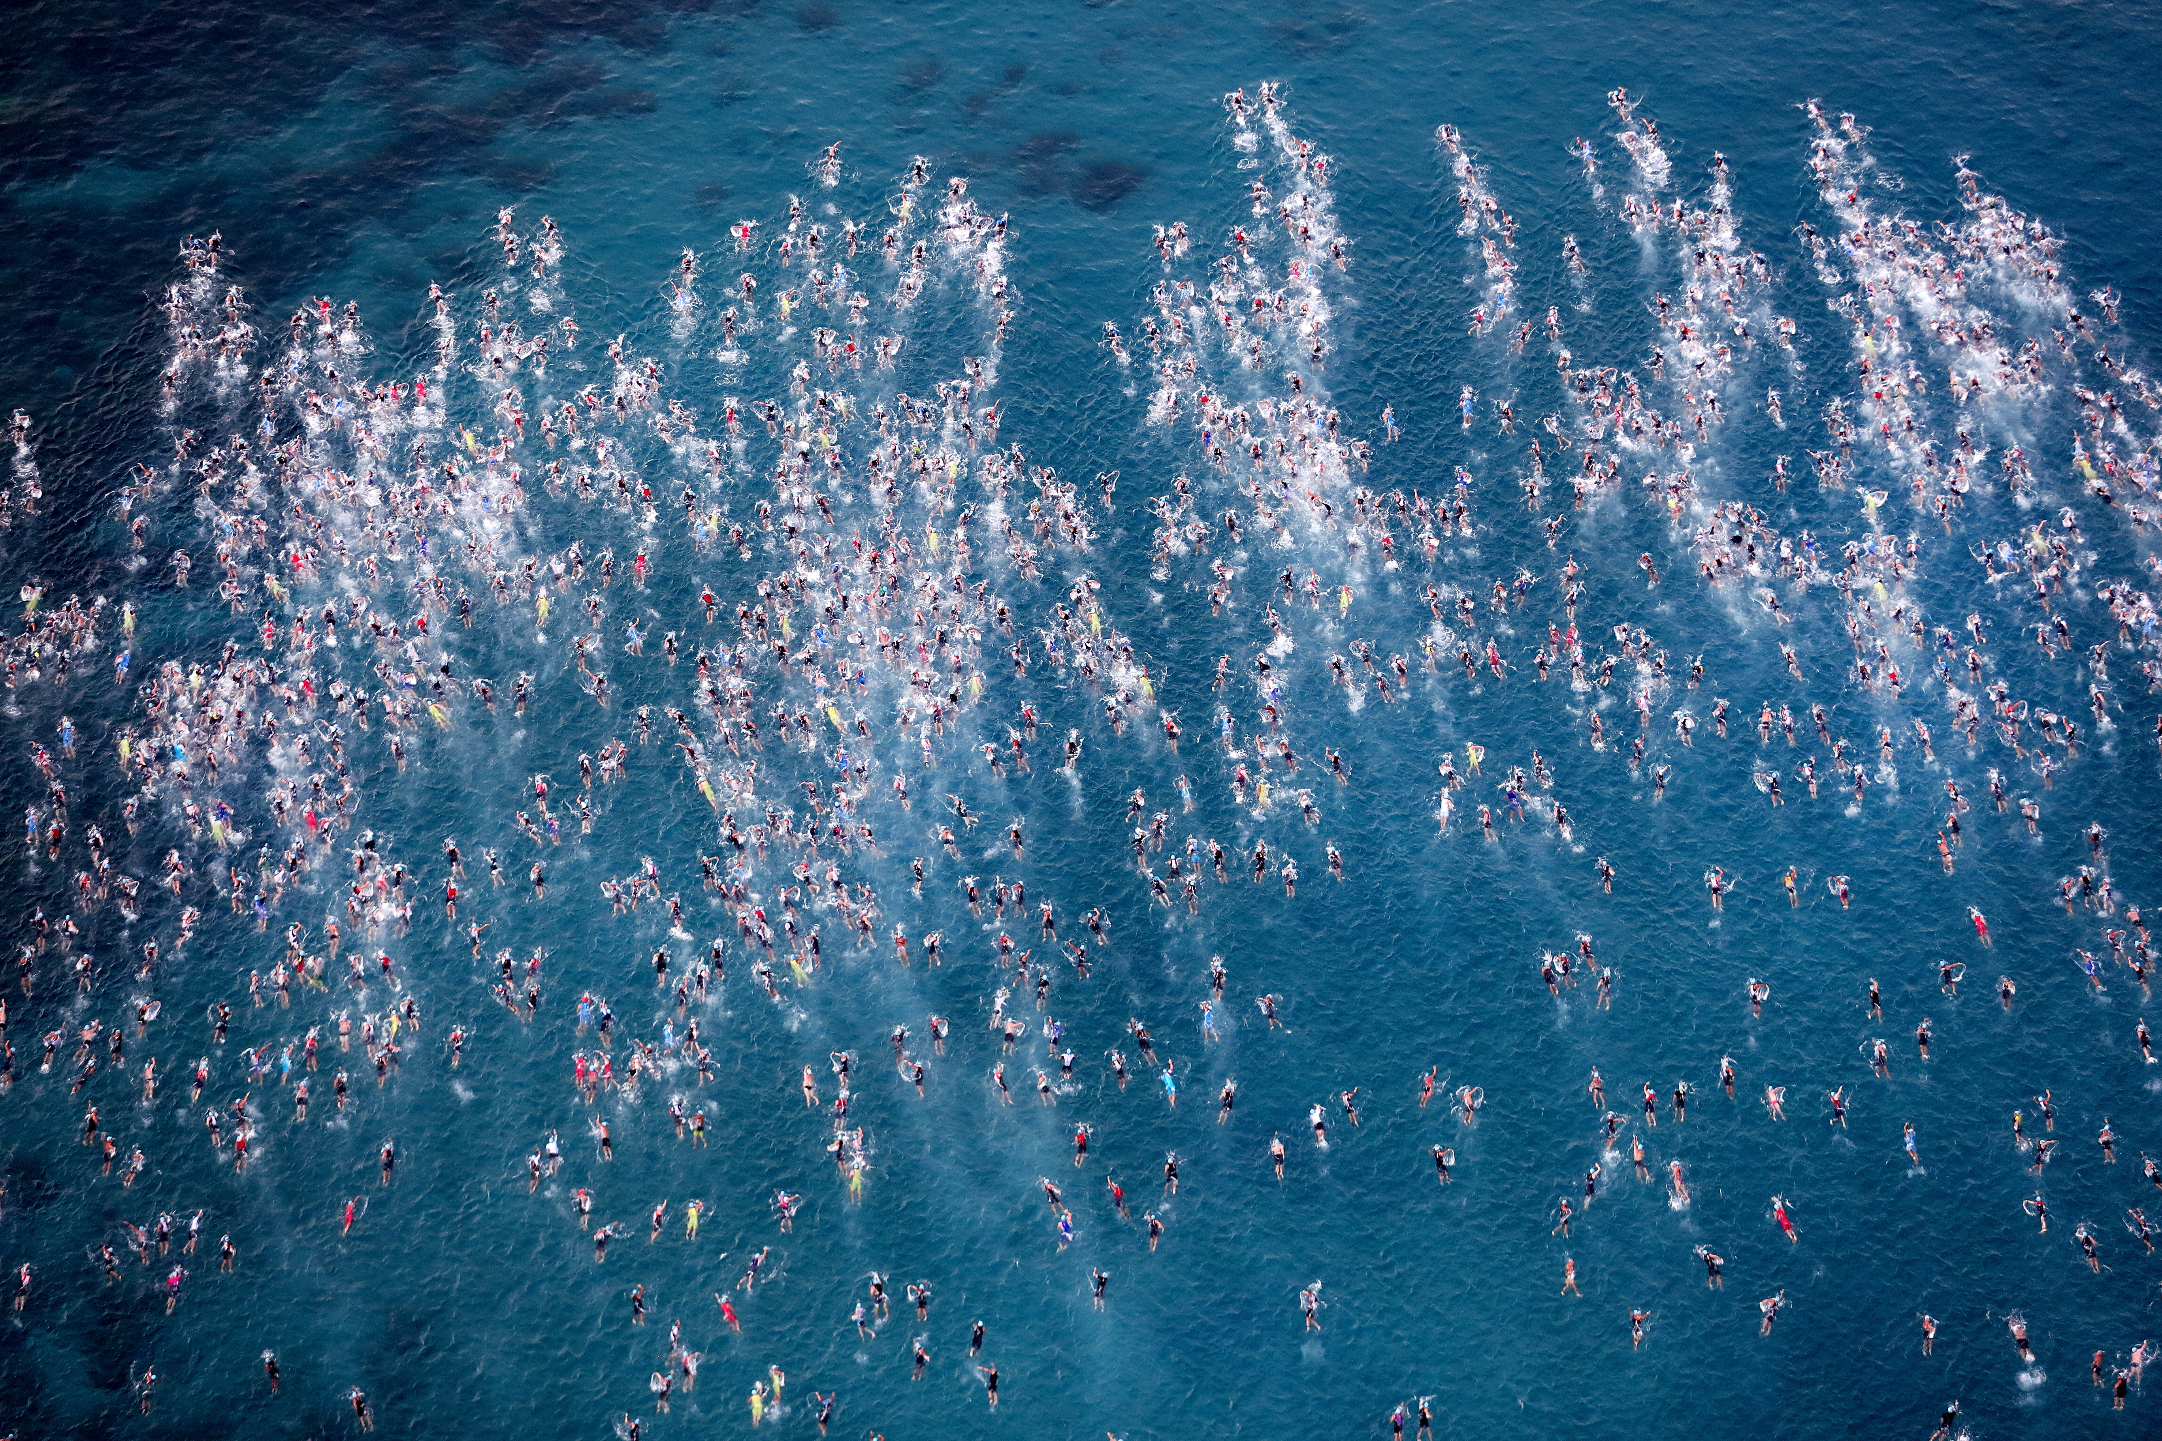
Questions?

